Slide 1
Simulation Results of with and without parasitics for 50 ohm input resistance
TIME DOMAIN COMPARISONS
Comparison of input currents
Comparison of leg currents
Comparison of capacitor currents
Frequency DOMAIN COMPARISONS
Comparison of input currents
Comparison of leg currents
Comparison of capacitor currents

Slide 2
TIME DOMAIN COMPARISONS
Comparison of input currents
Comparison of leg currents
Comparison of capacitor currents

Slide 3
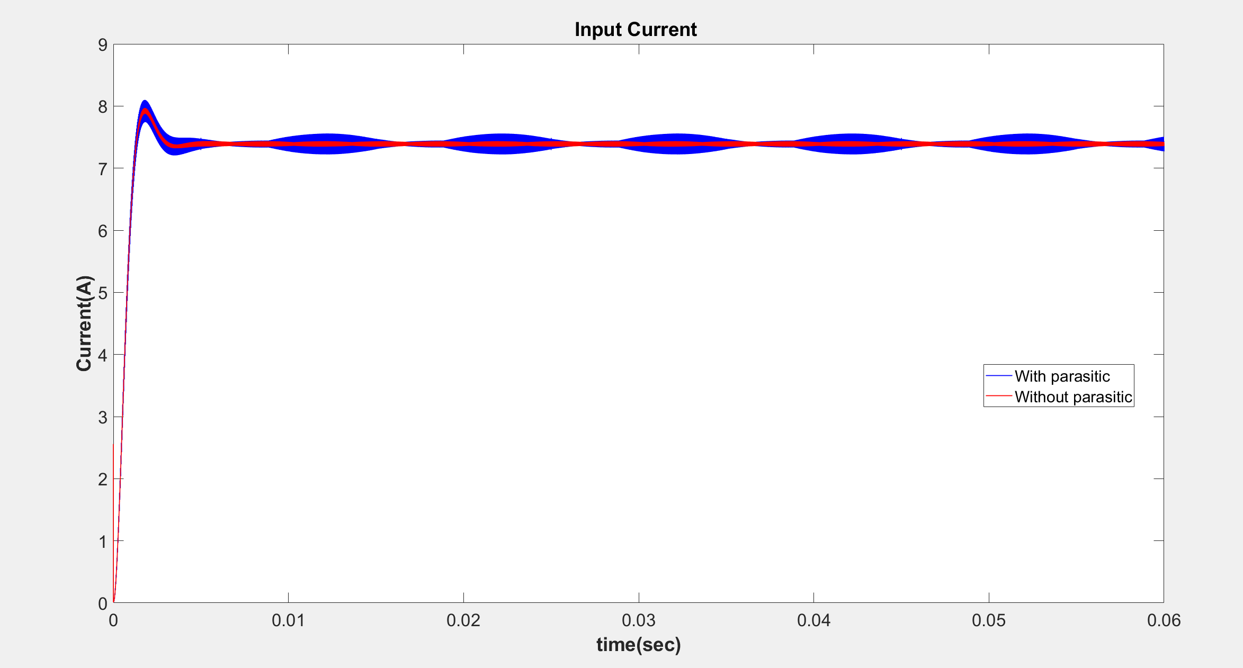

Slide 4
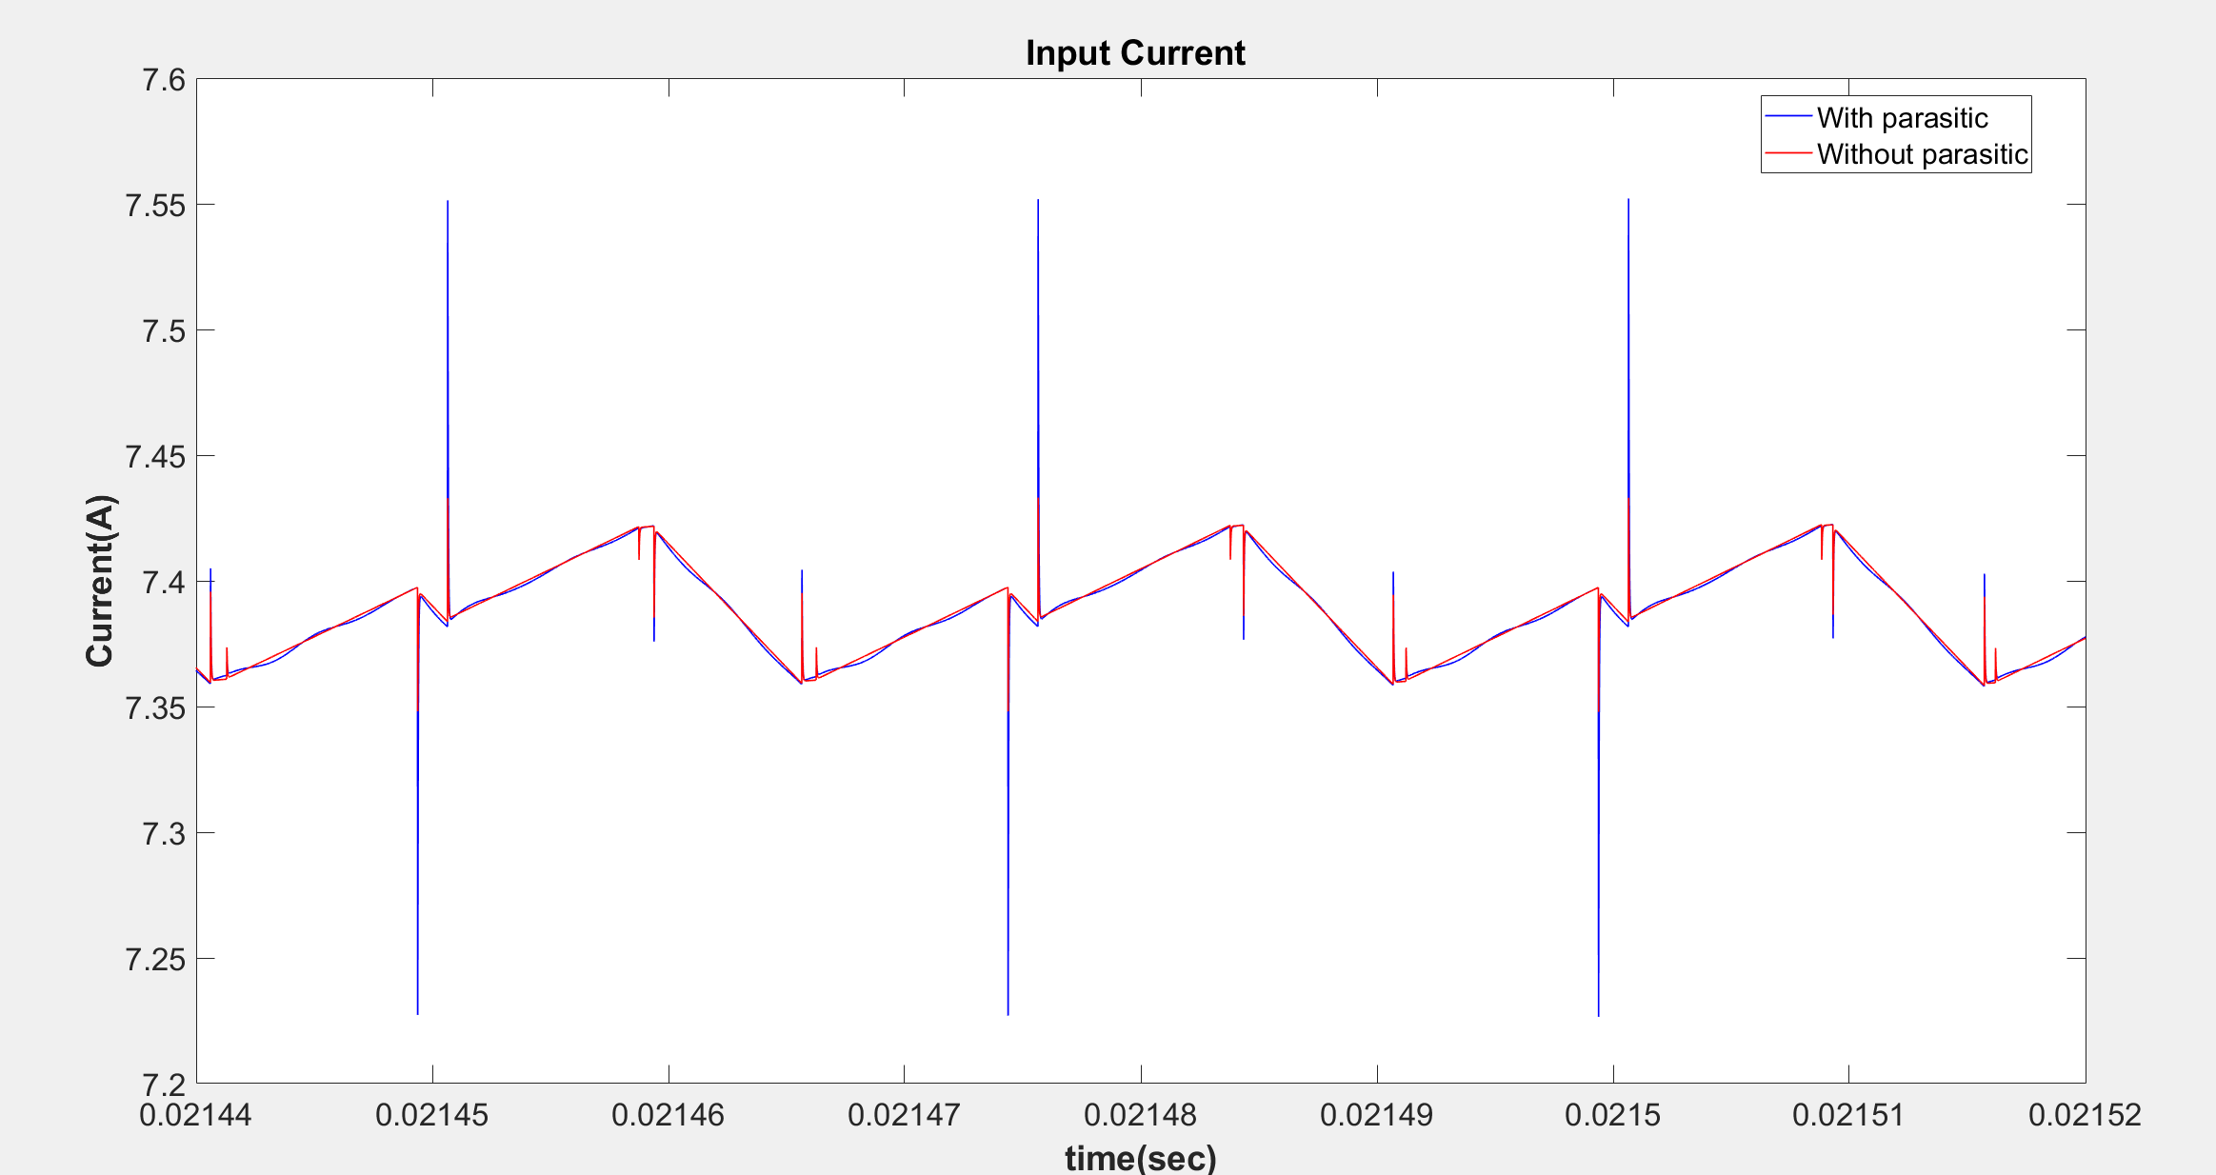

Slide 5
 | Input Current (Mean)
With Parasitic | 7.3198
Without Parasitic | 7.3204

Slide 6
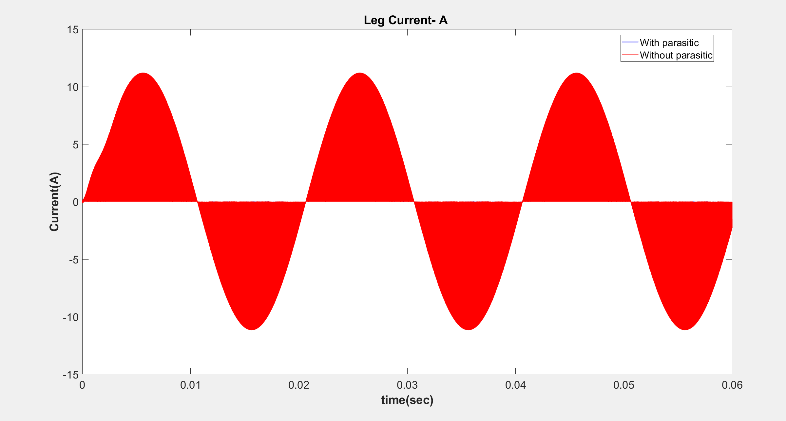

Slide 7
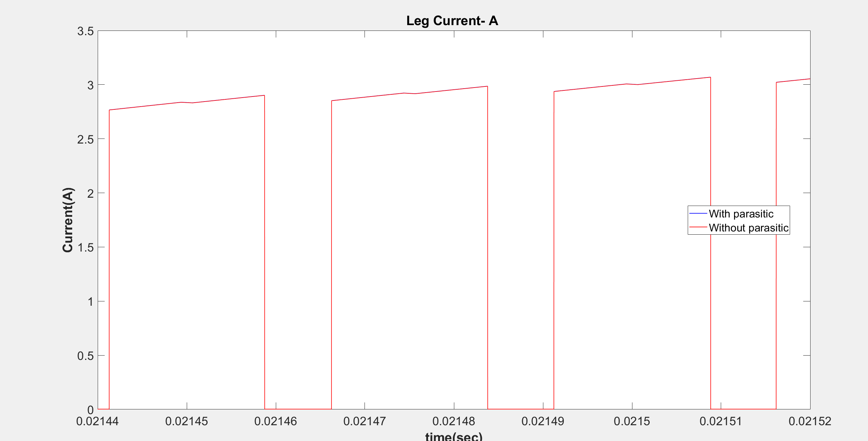

Slide 8
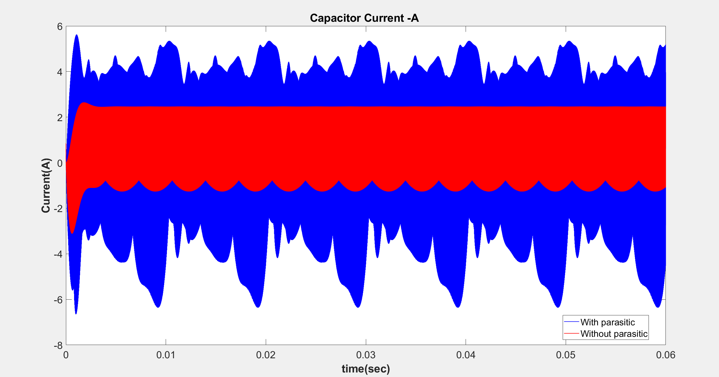

Slide 9
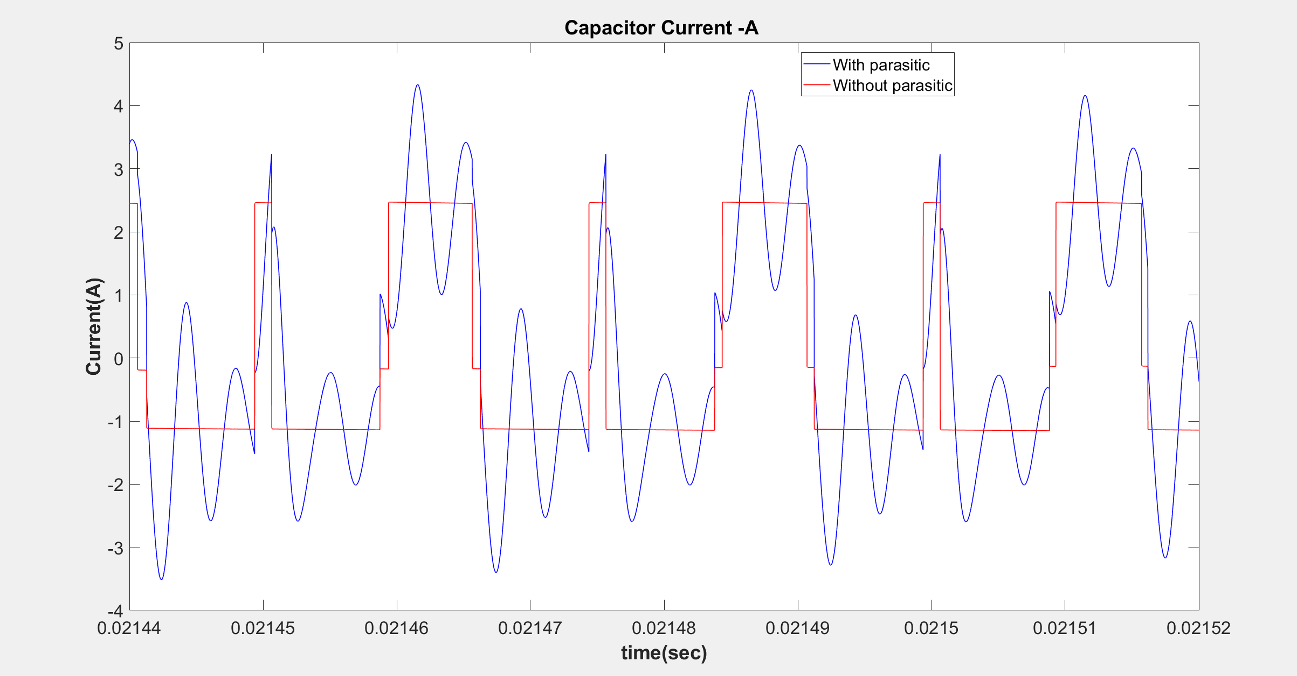

Slide 10
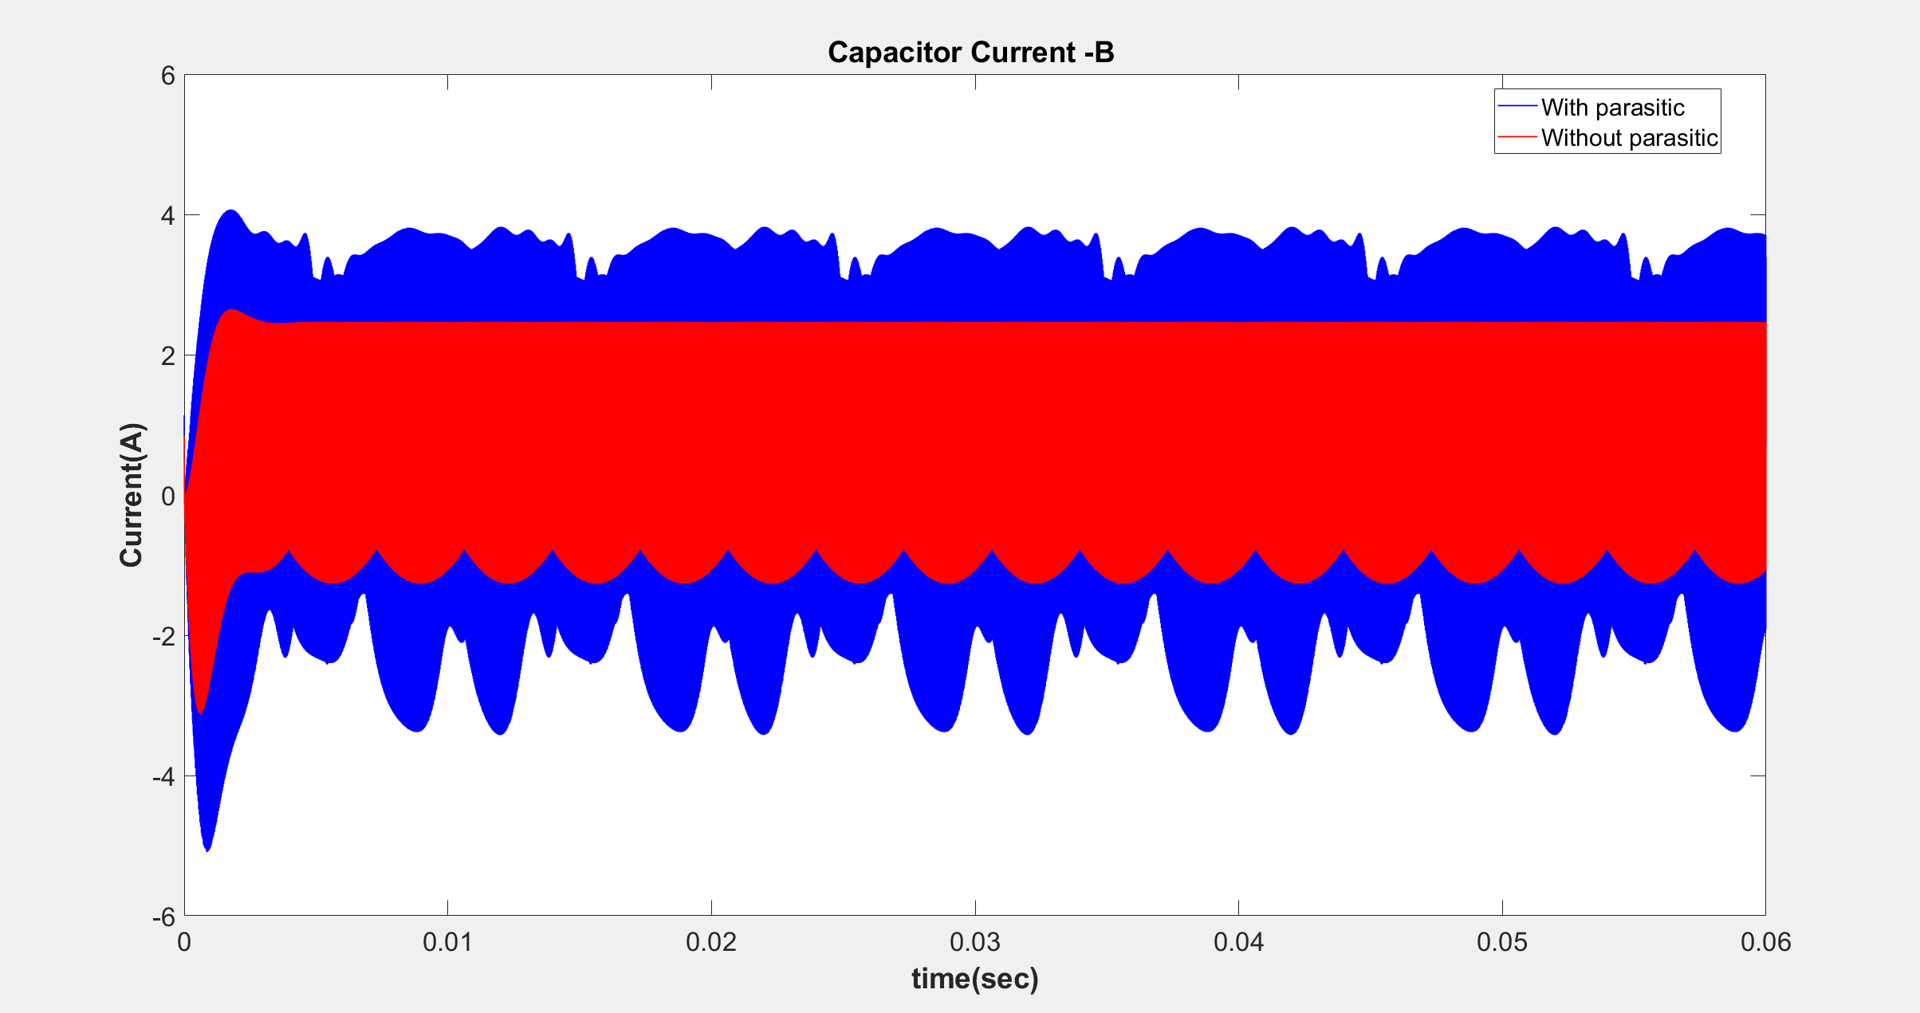

Slide 11
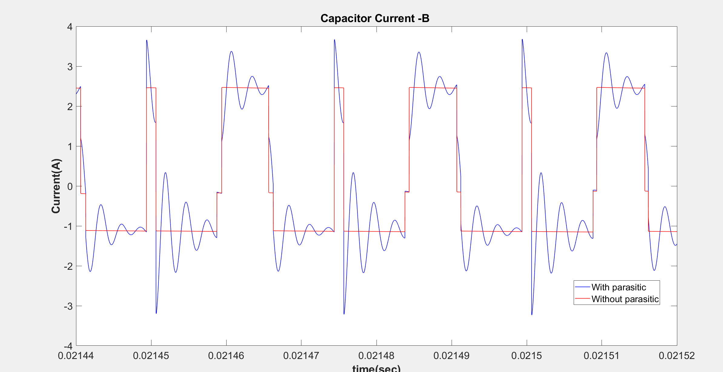

Slide 12
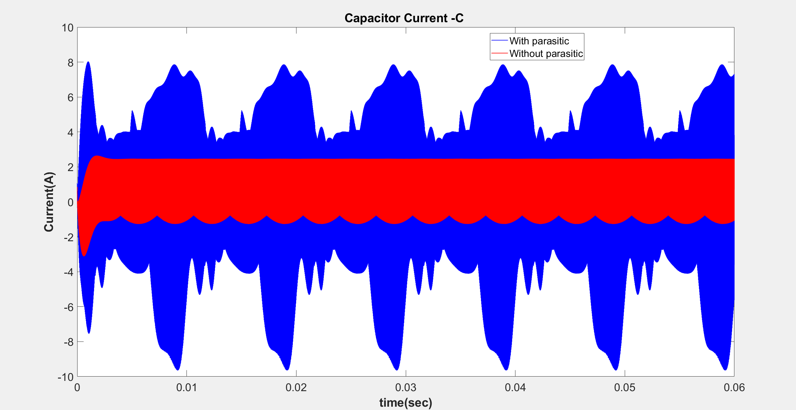

Slide 13
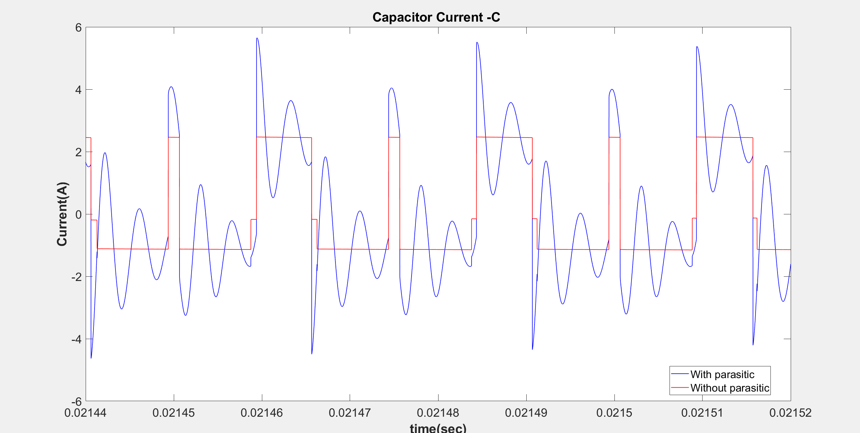

Slide 14
Frequency DOMAIN COMPARISONS
Comparison of input currents
Comparison of leg currents
Comparison of capacitor currents

Slide 15
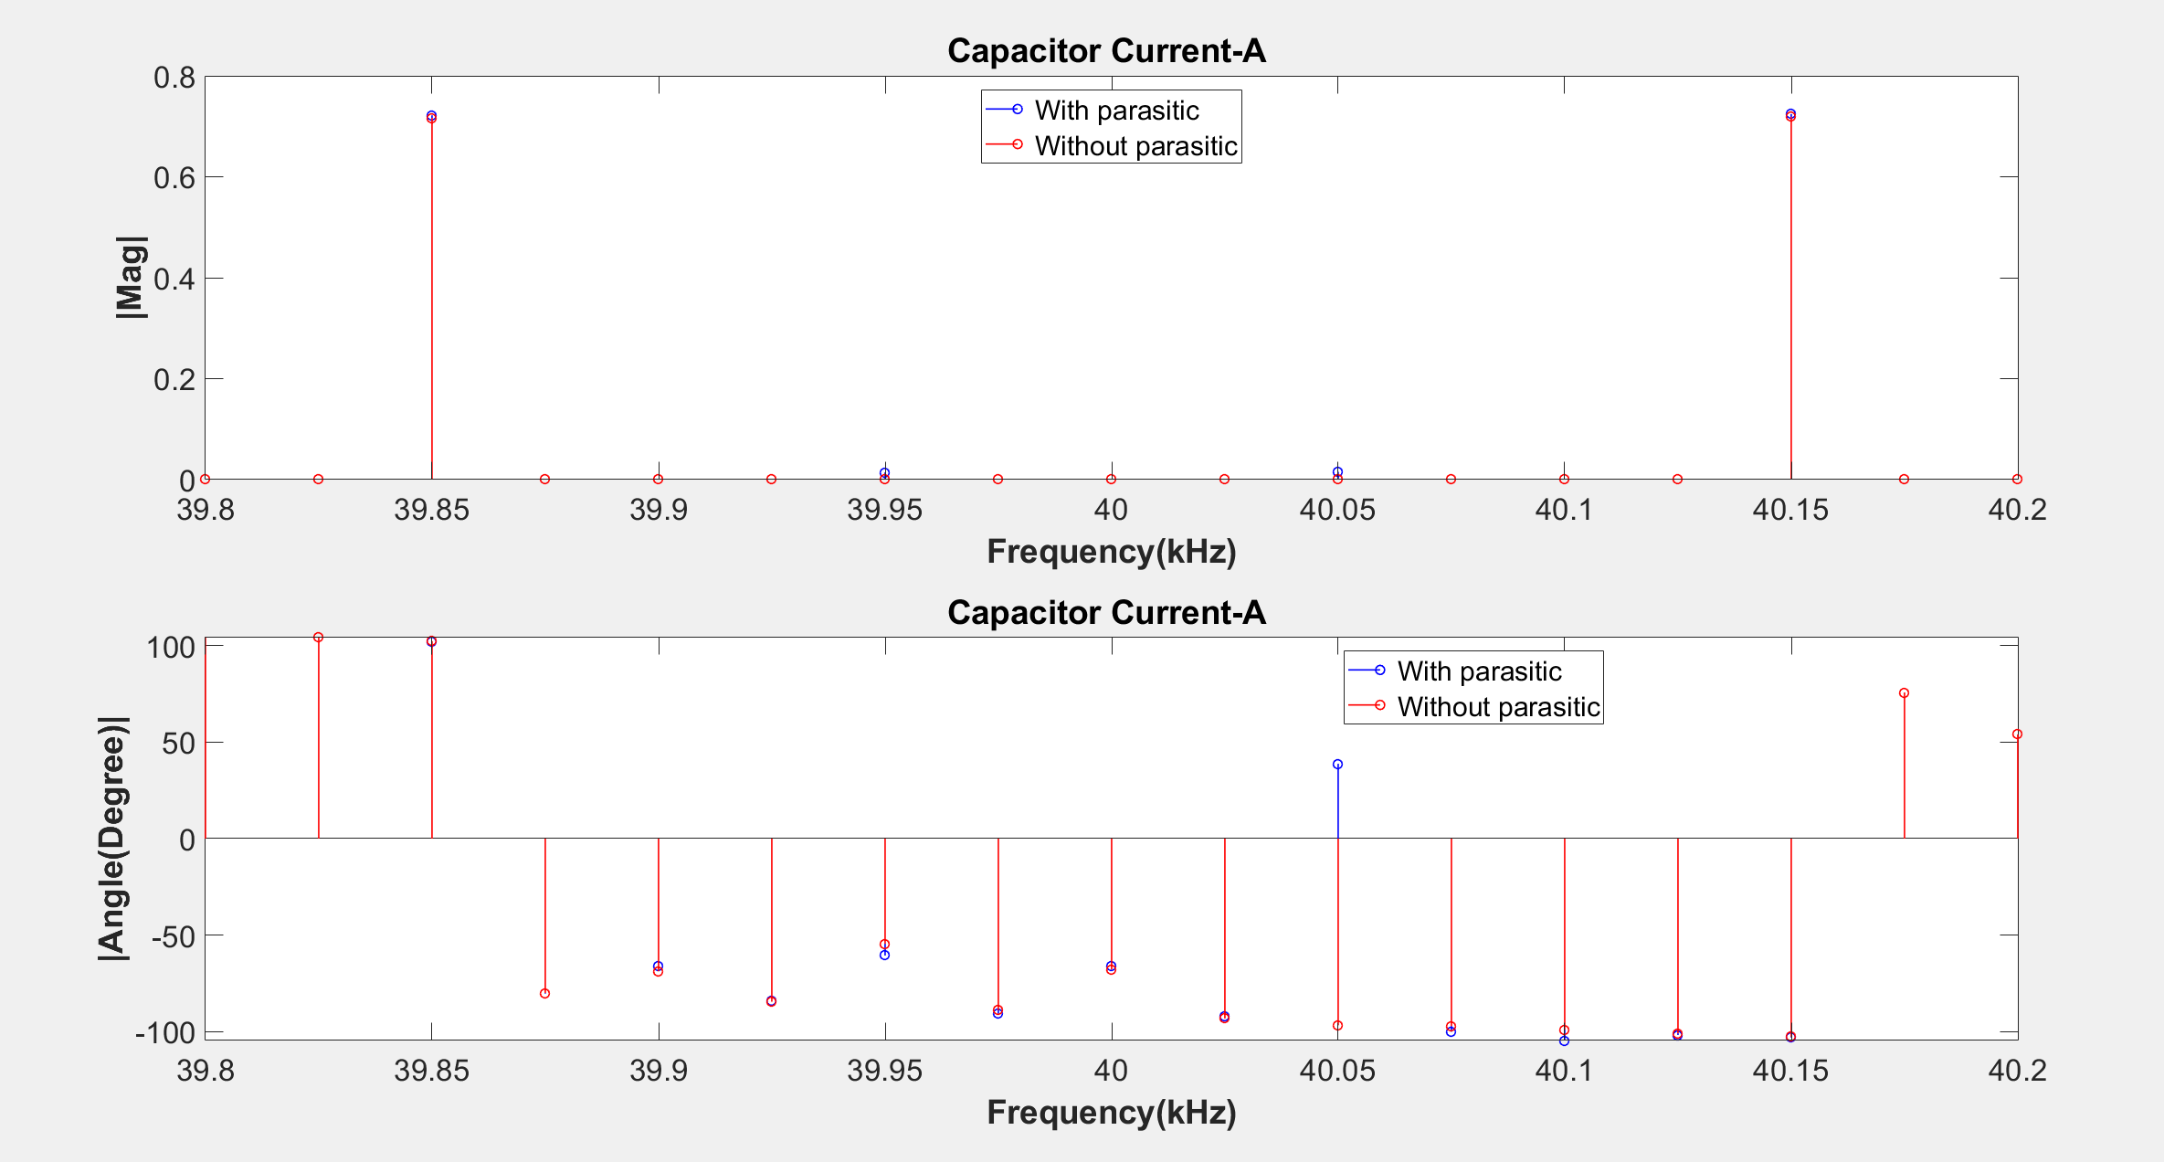

Slide 16
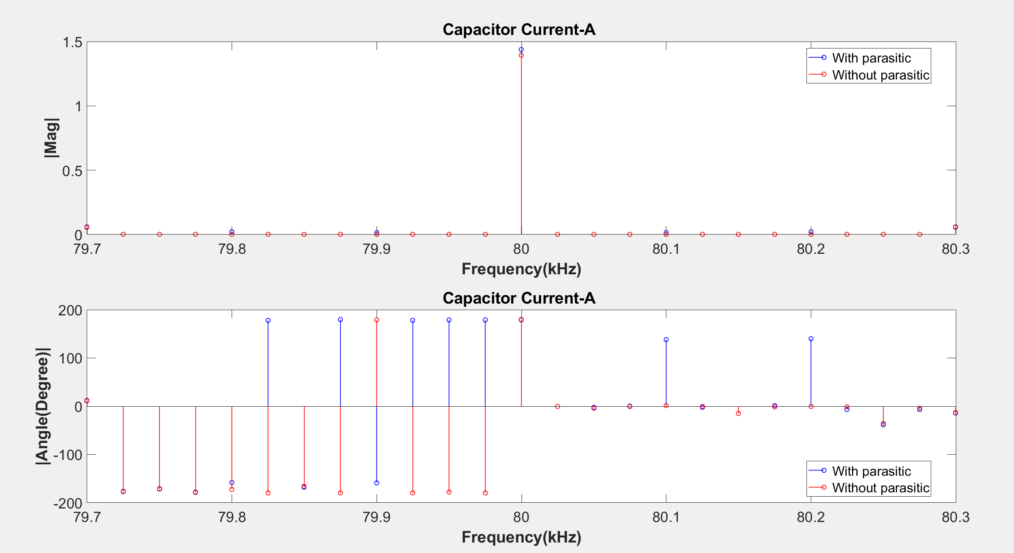

Slide 17
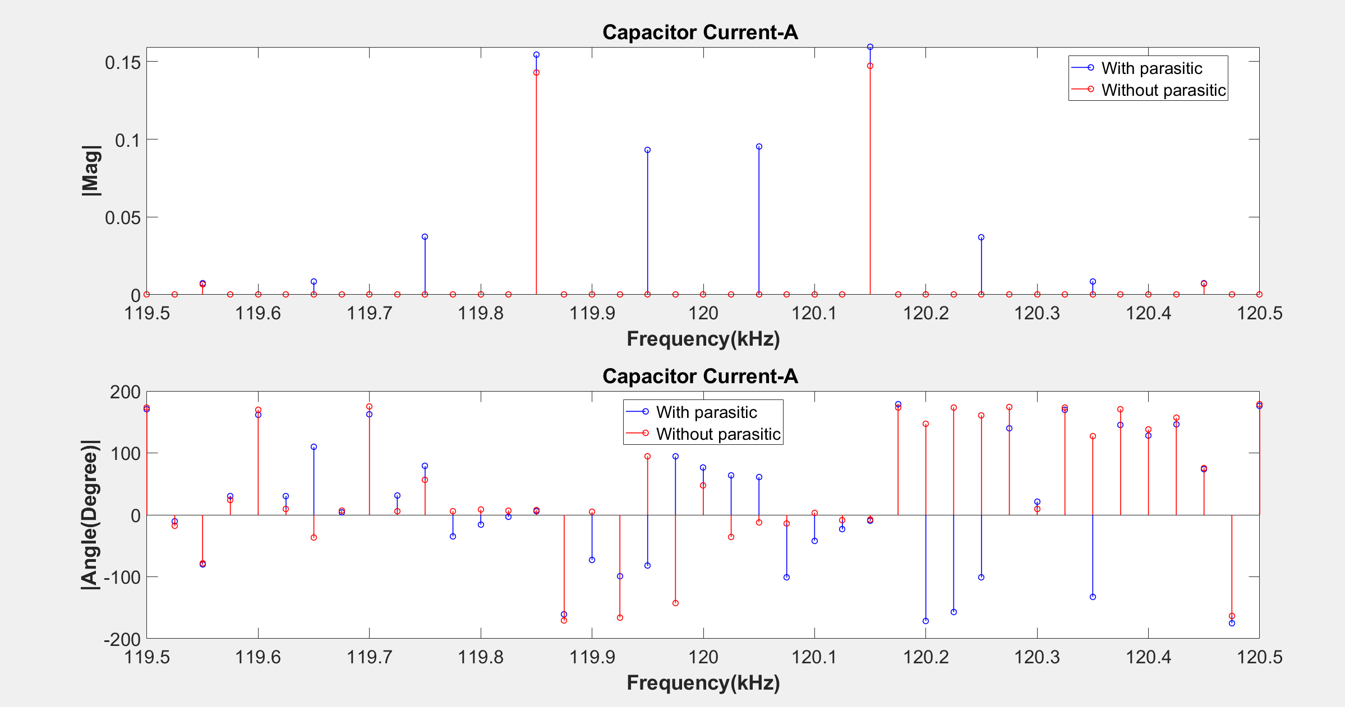

Slide 18
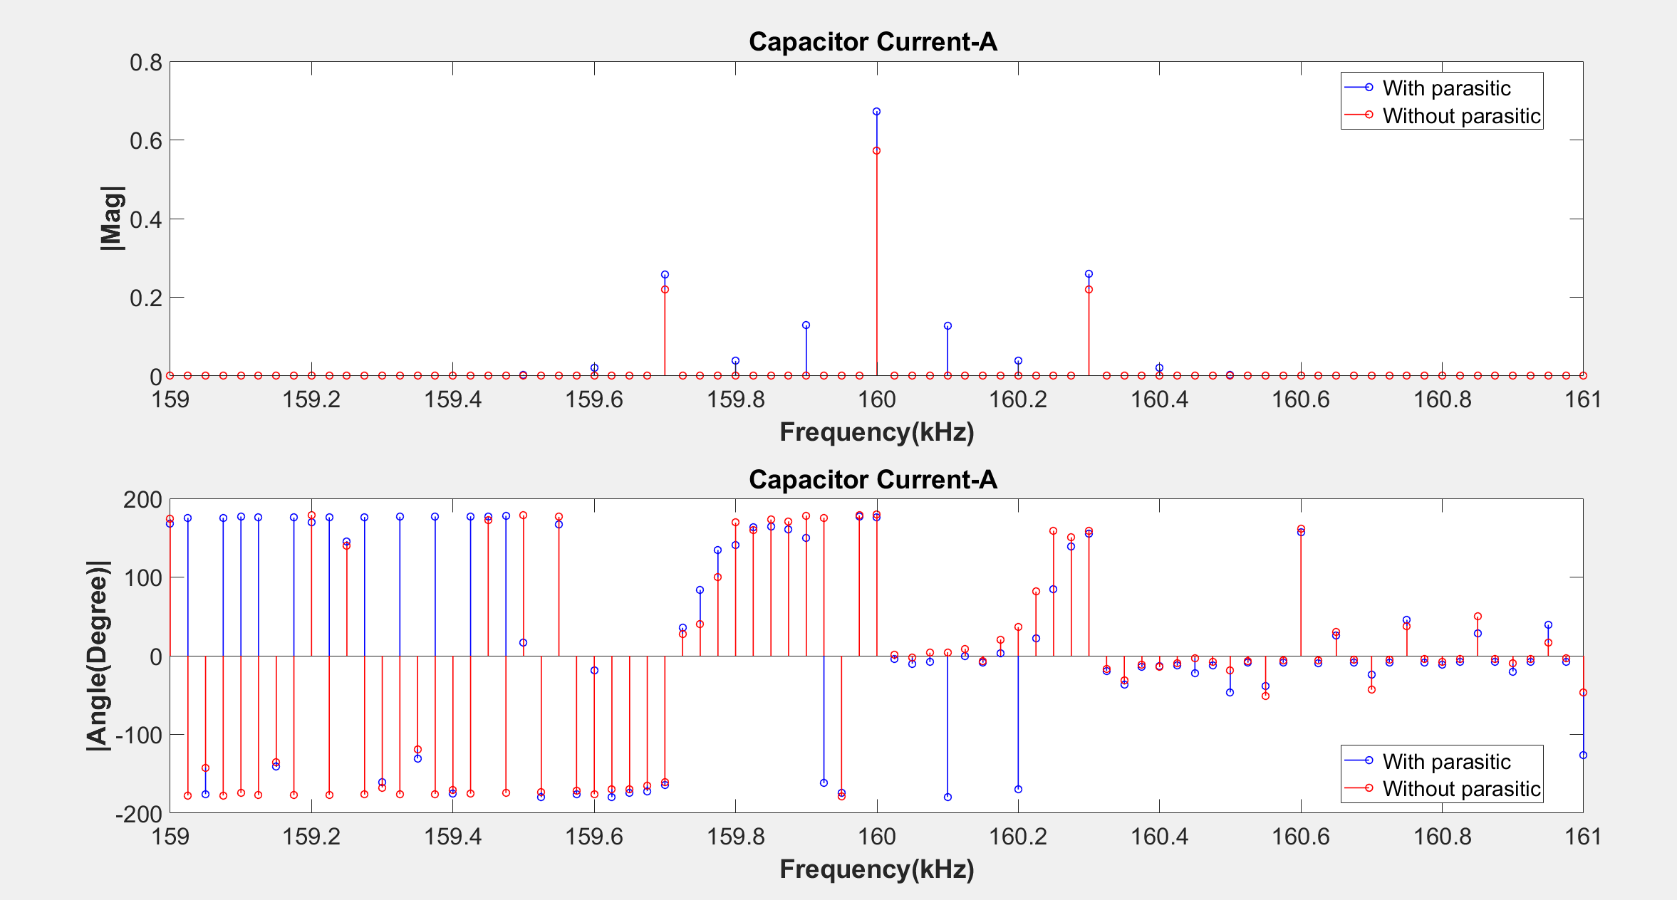

Slide 19
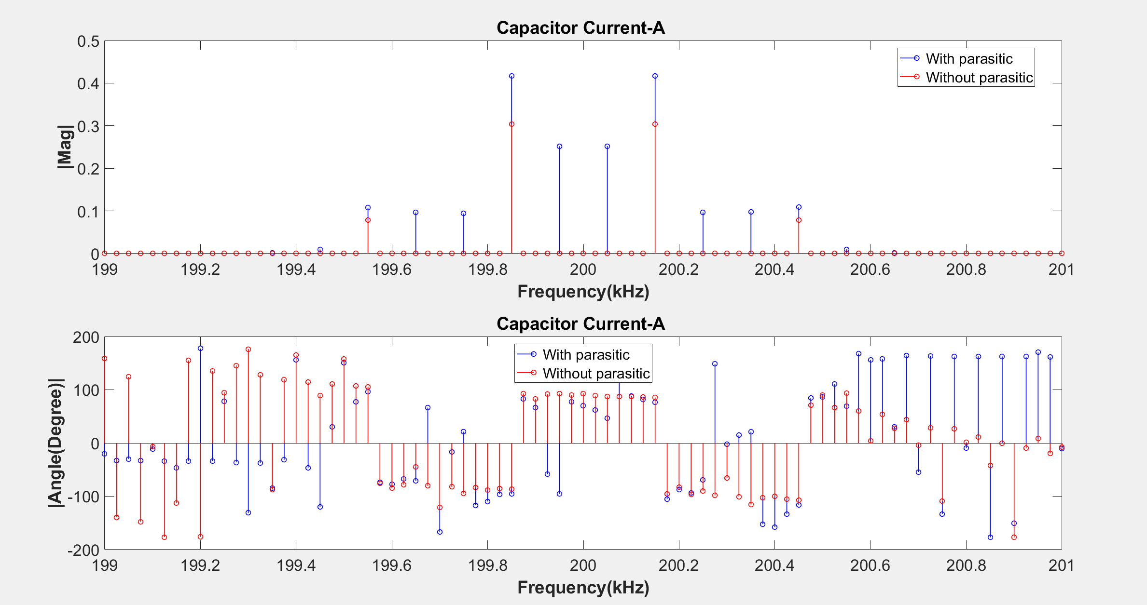

Slide 20
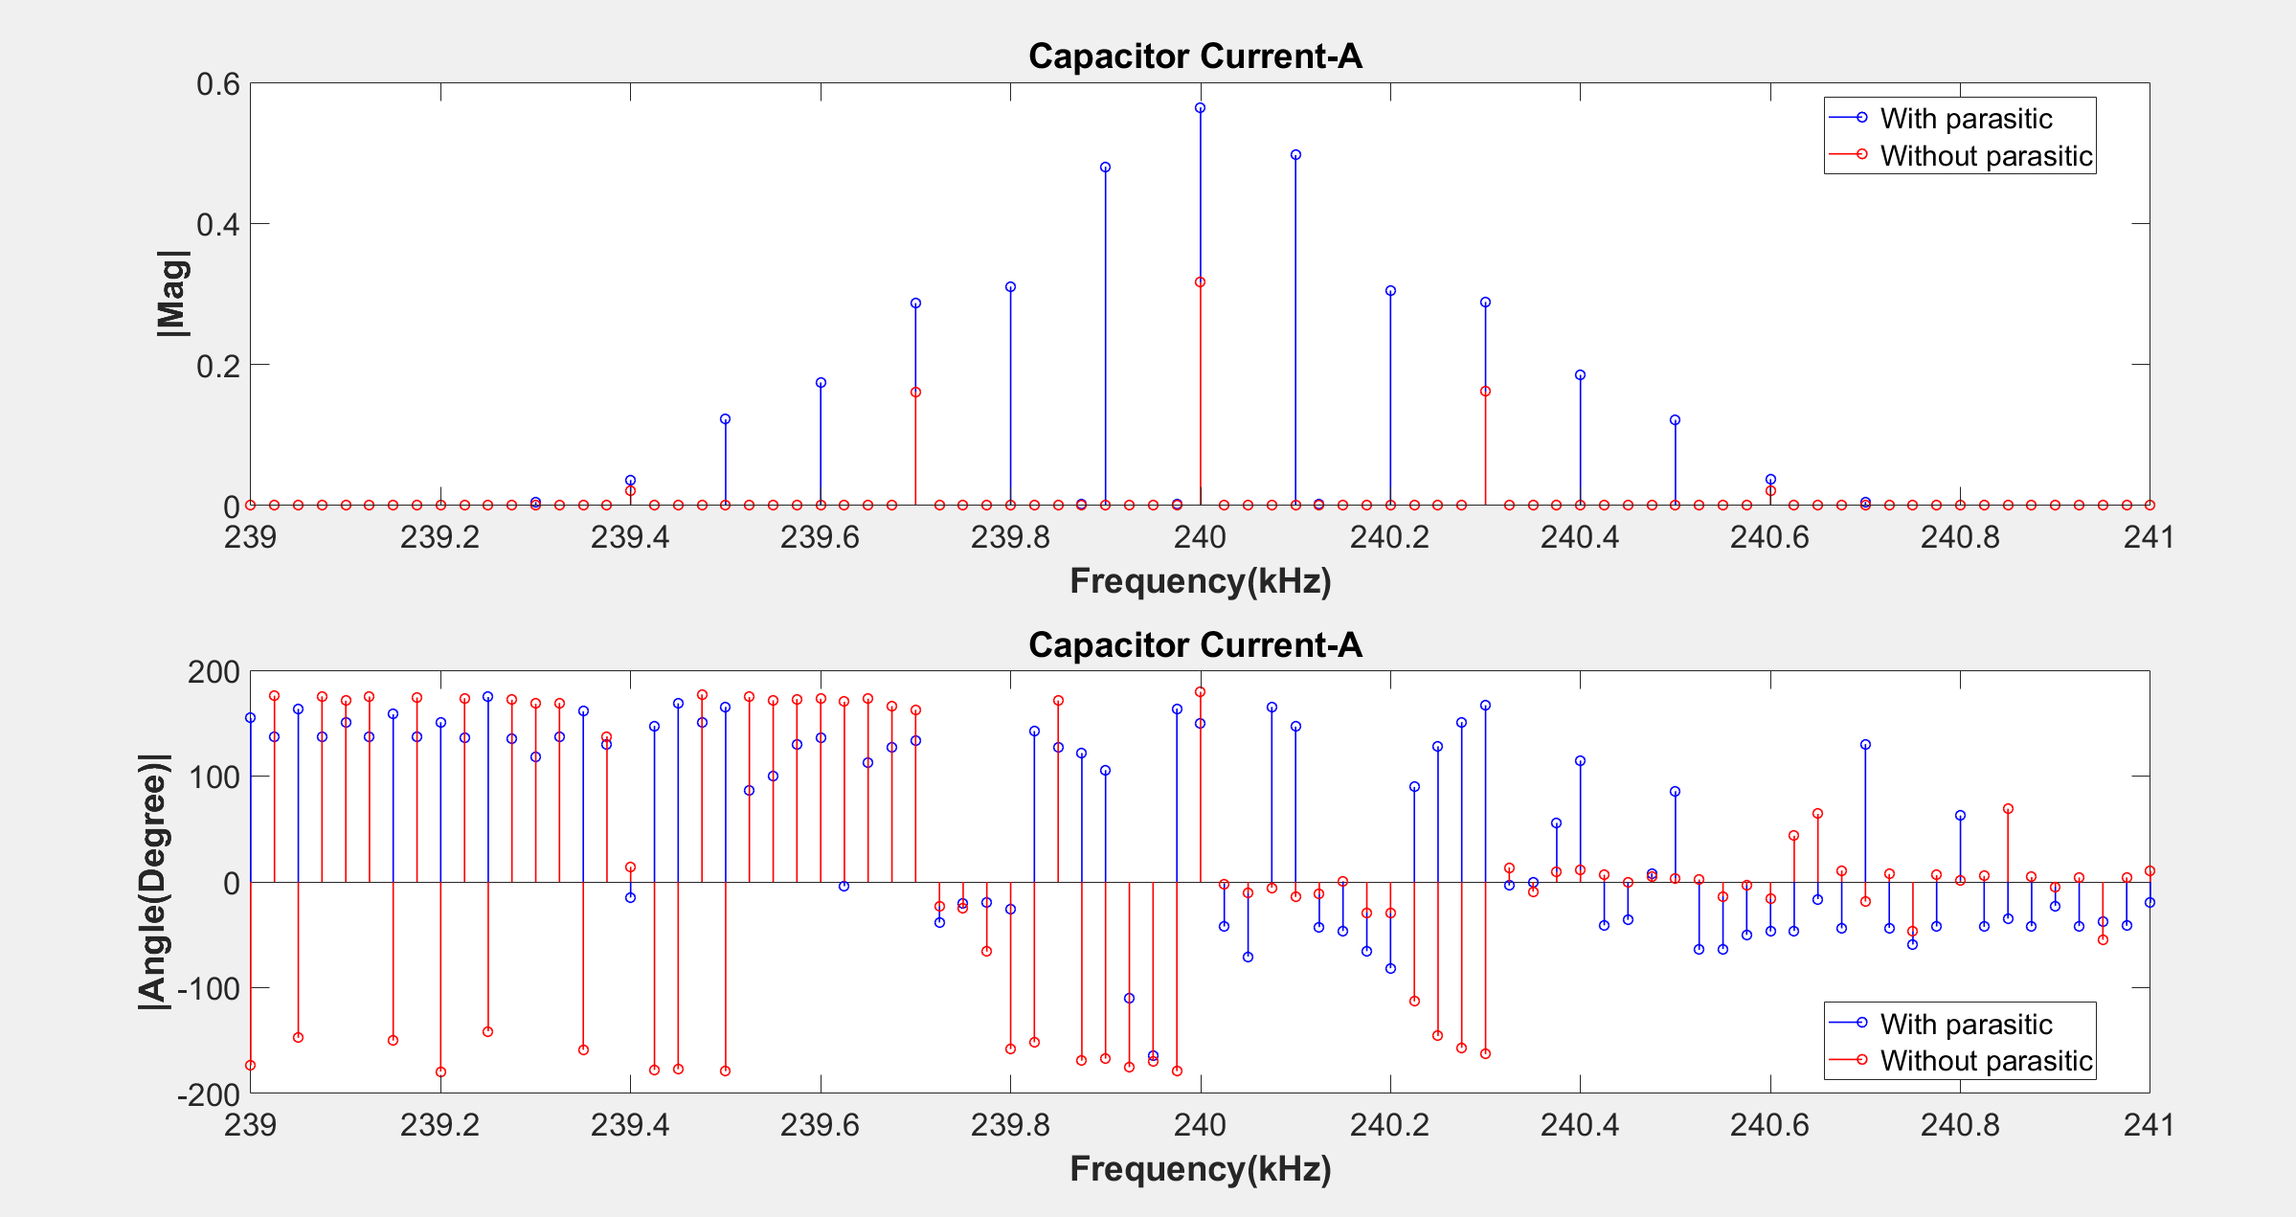

Slide 27
Simulation Results of with and without parasitics for 0.1 ohm input resistance
TIME DOMAIN COMPARISONS
Comparison of input currents
Comparison of leg currents
Comparison of capacitor currents
Frequency DOMAIN COMPARISONS
Comparison of input currents
Comparison of leg currents
Comparison of capacitor currents

Slide 28
TIME DOMAIN COMPARISONS
Comparison of input currents
Comparison of leg currents
Comparison of capacitor currents

Slide 29
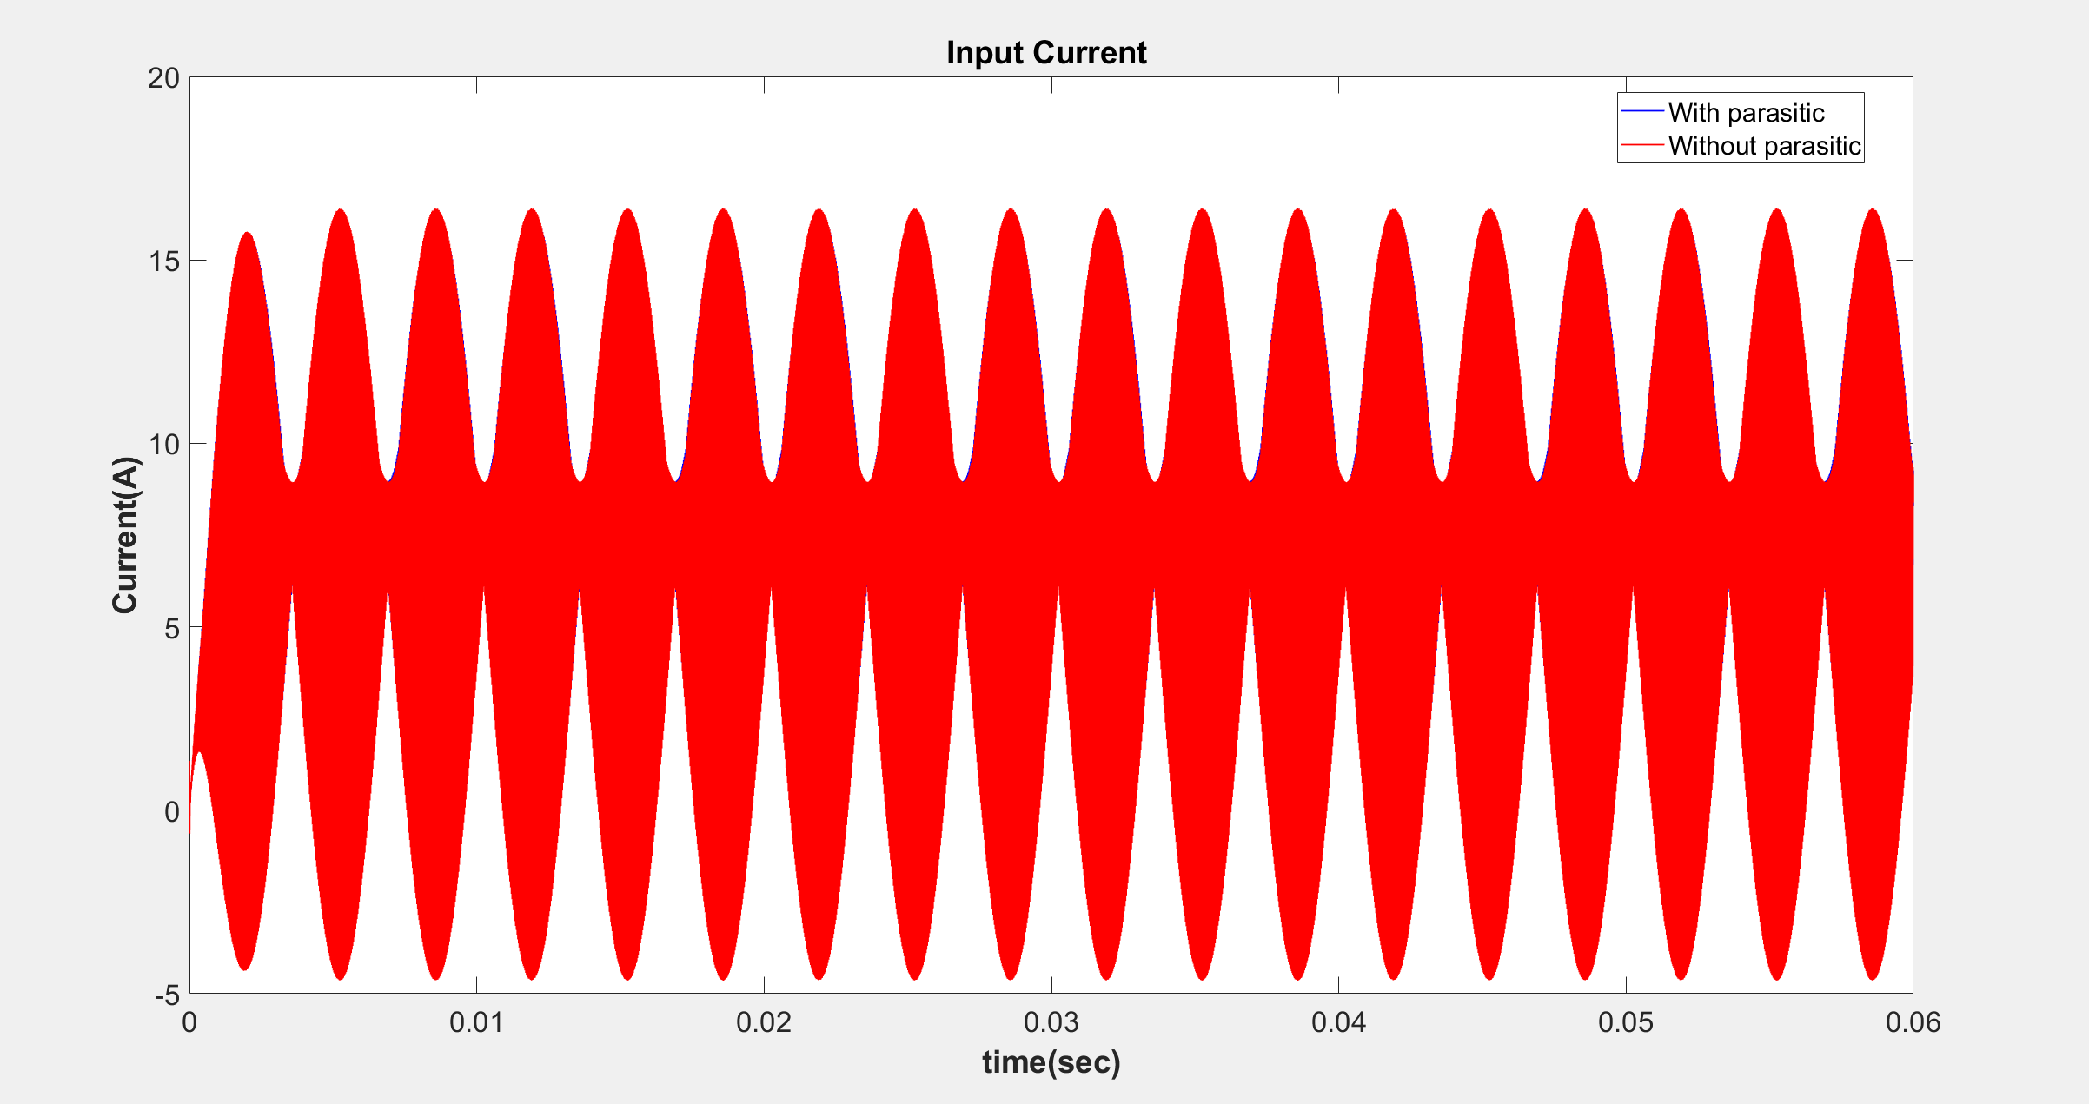

Slide 30
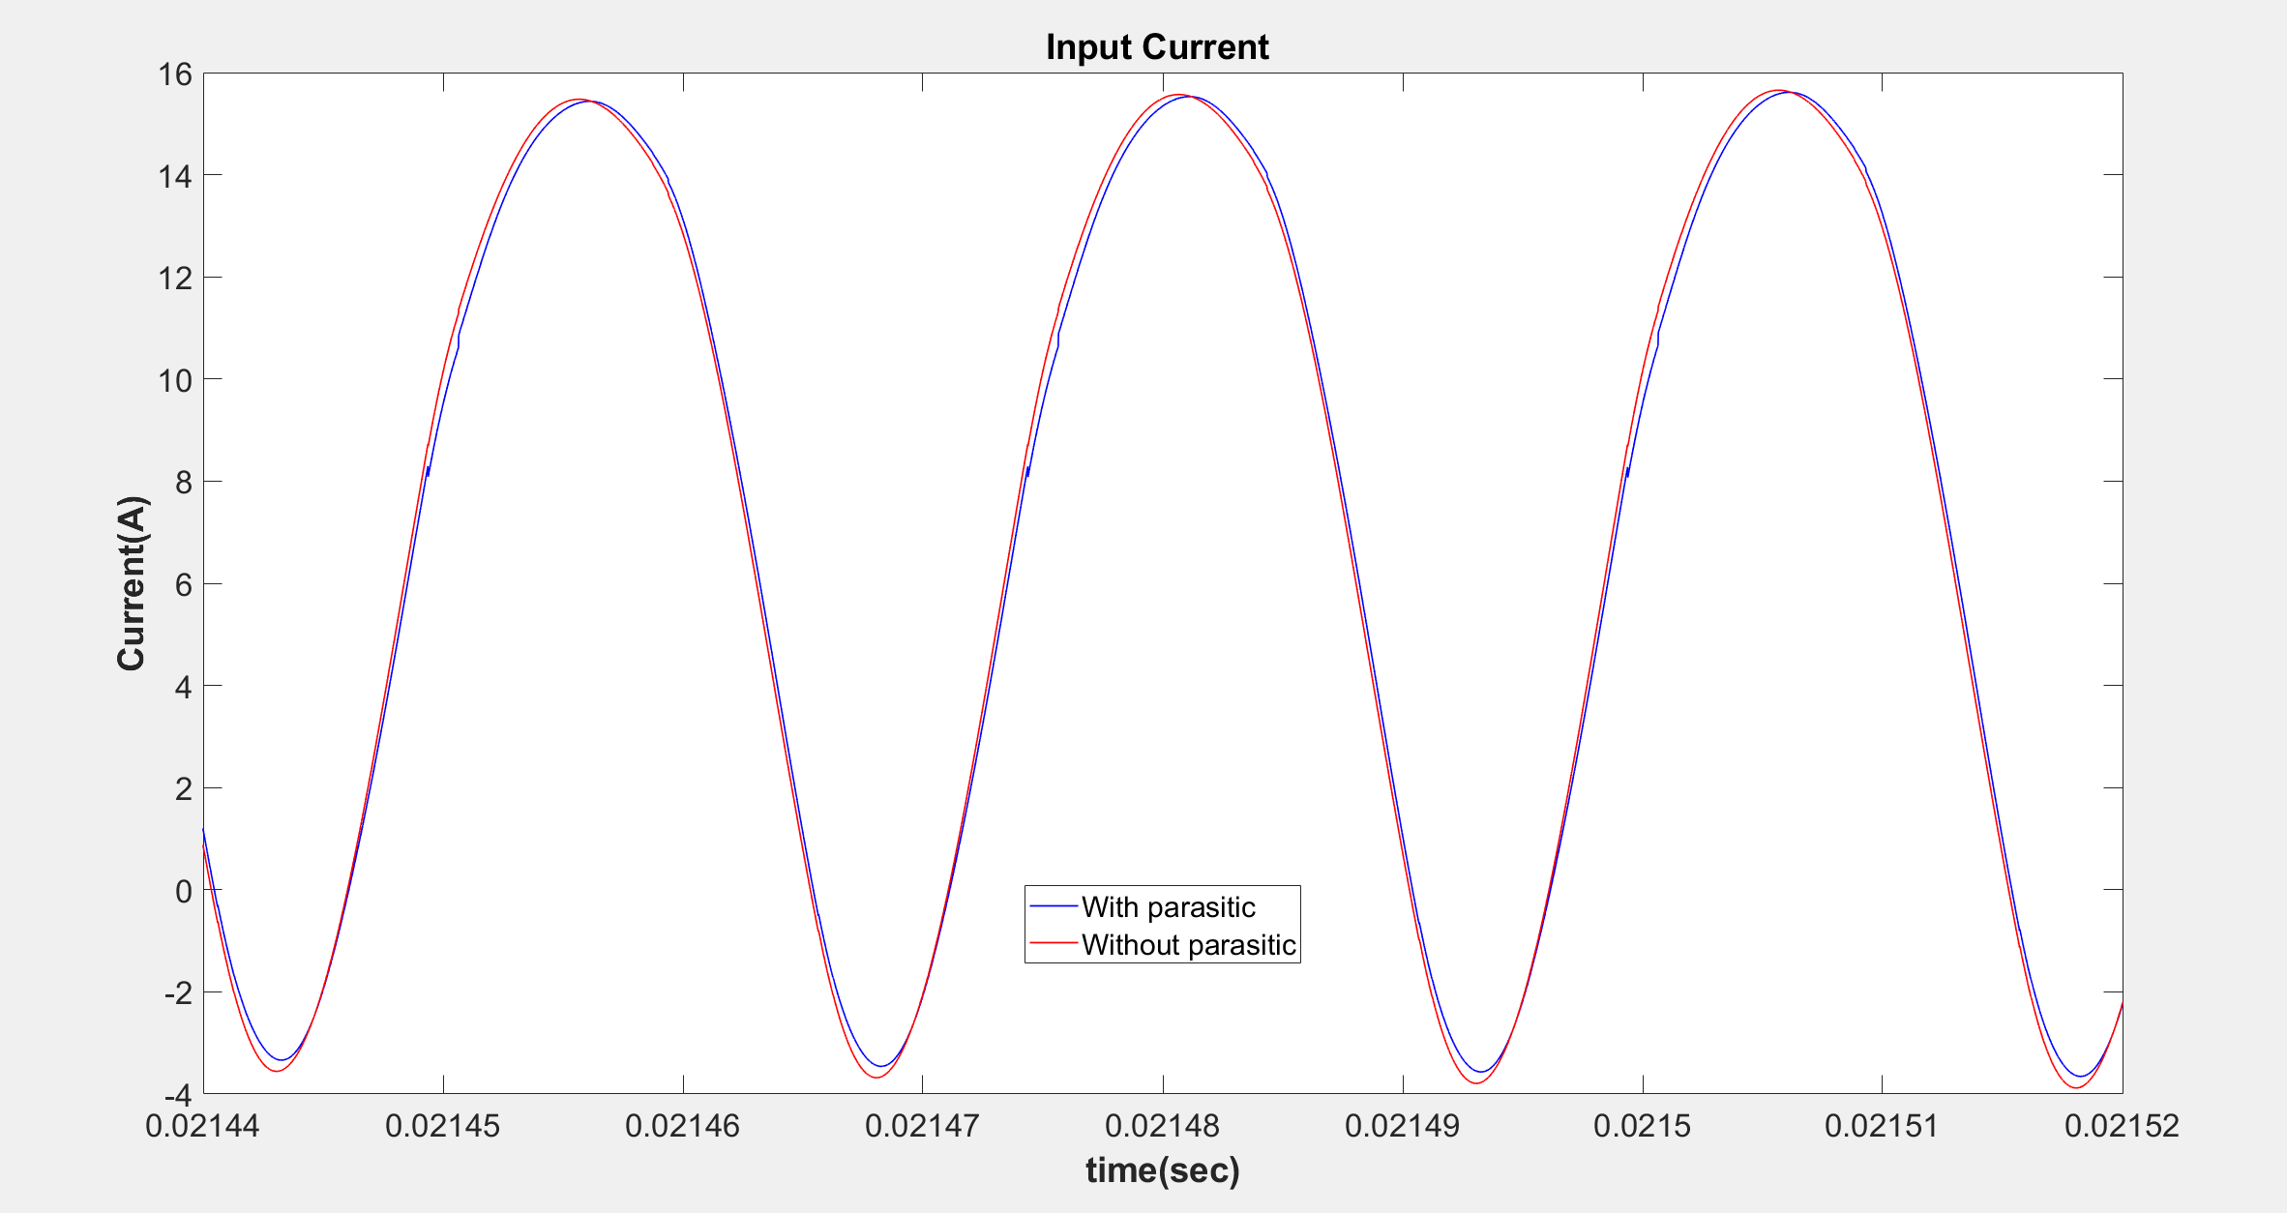

Slide 31
 | Input Current (Mean)
With Parasitic | 7.2831
Without Parasitic | 7.2844

Slide 32
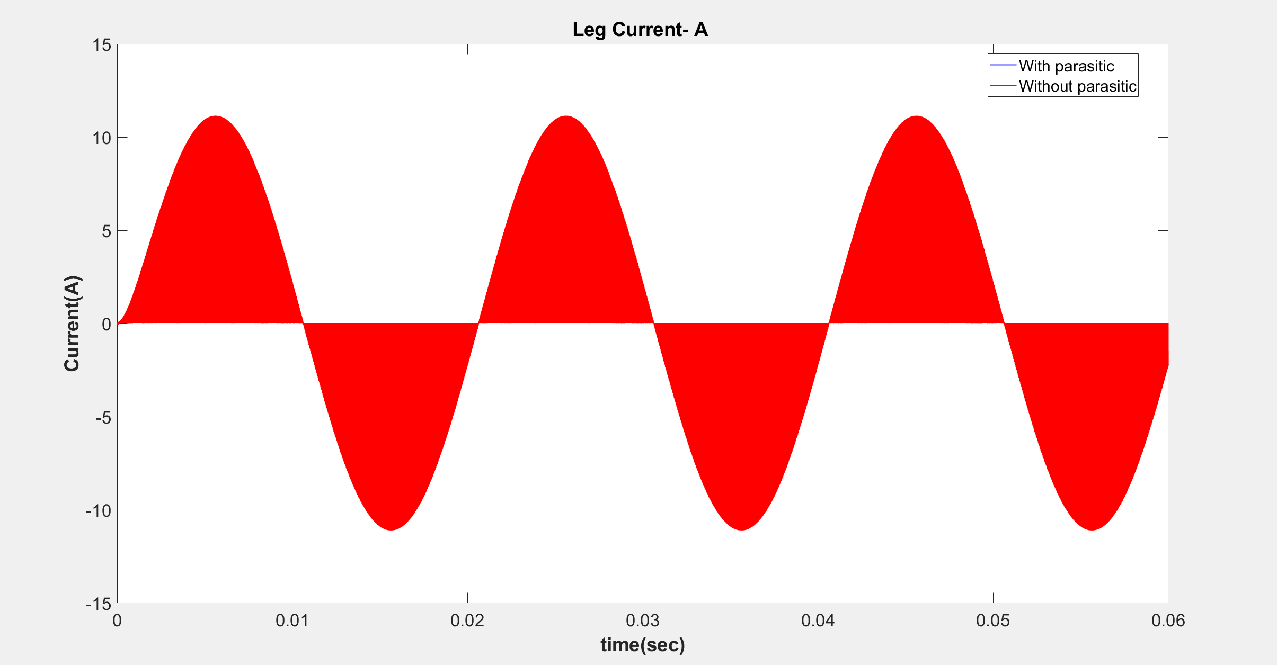

Slide 33
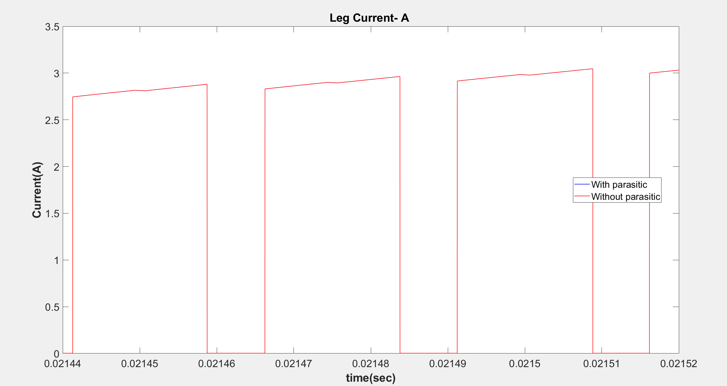

Slide 34
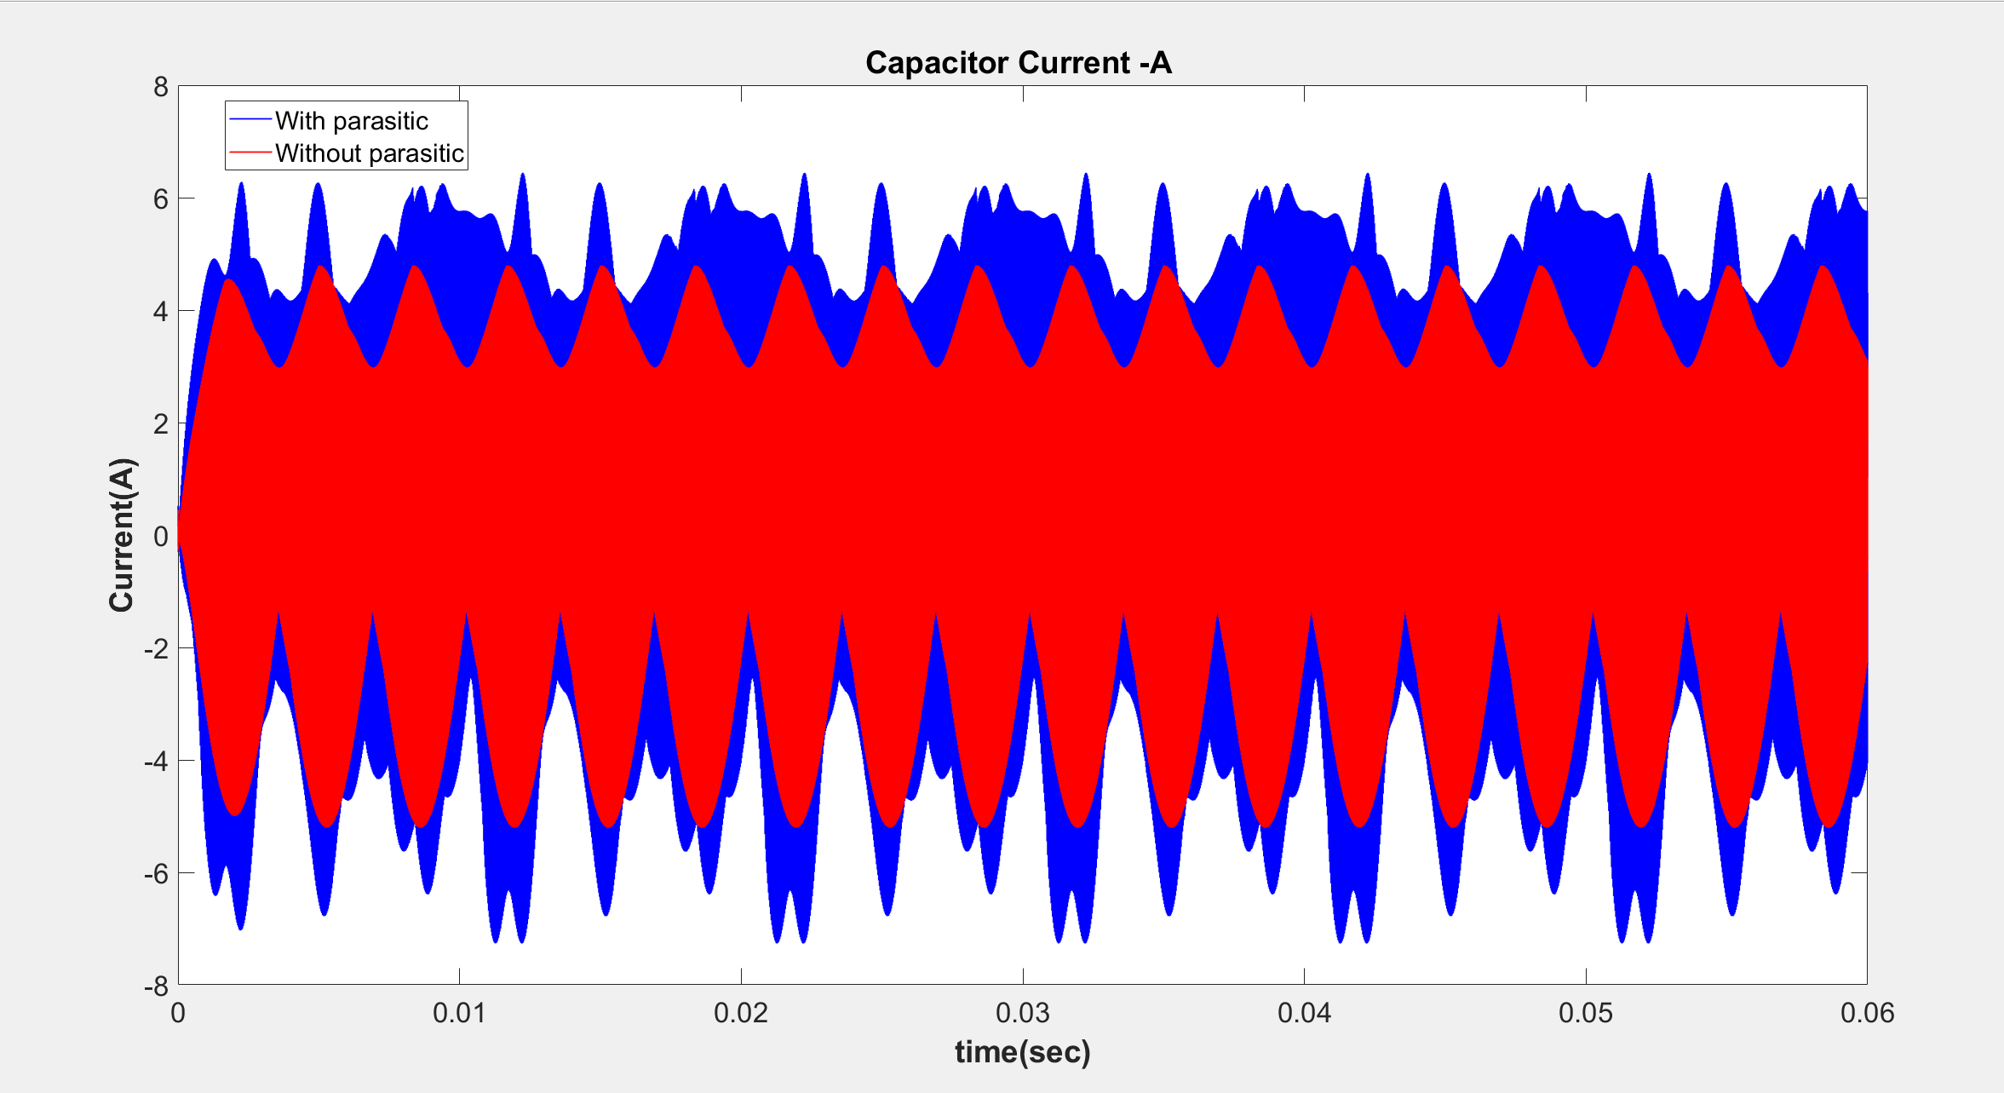

Slide 35
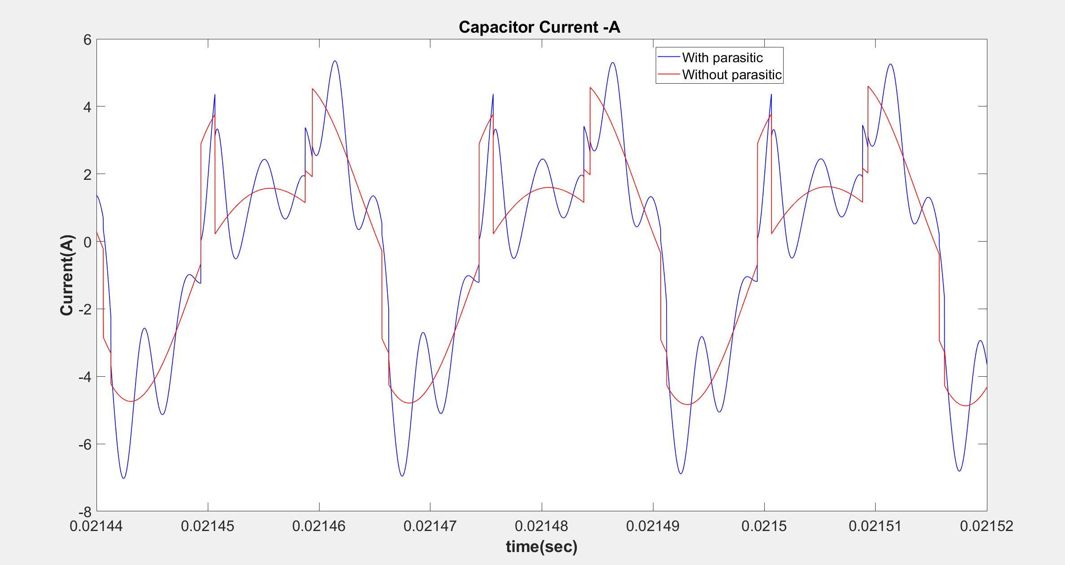

Slide 36
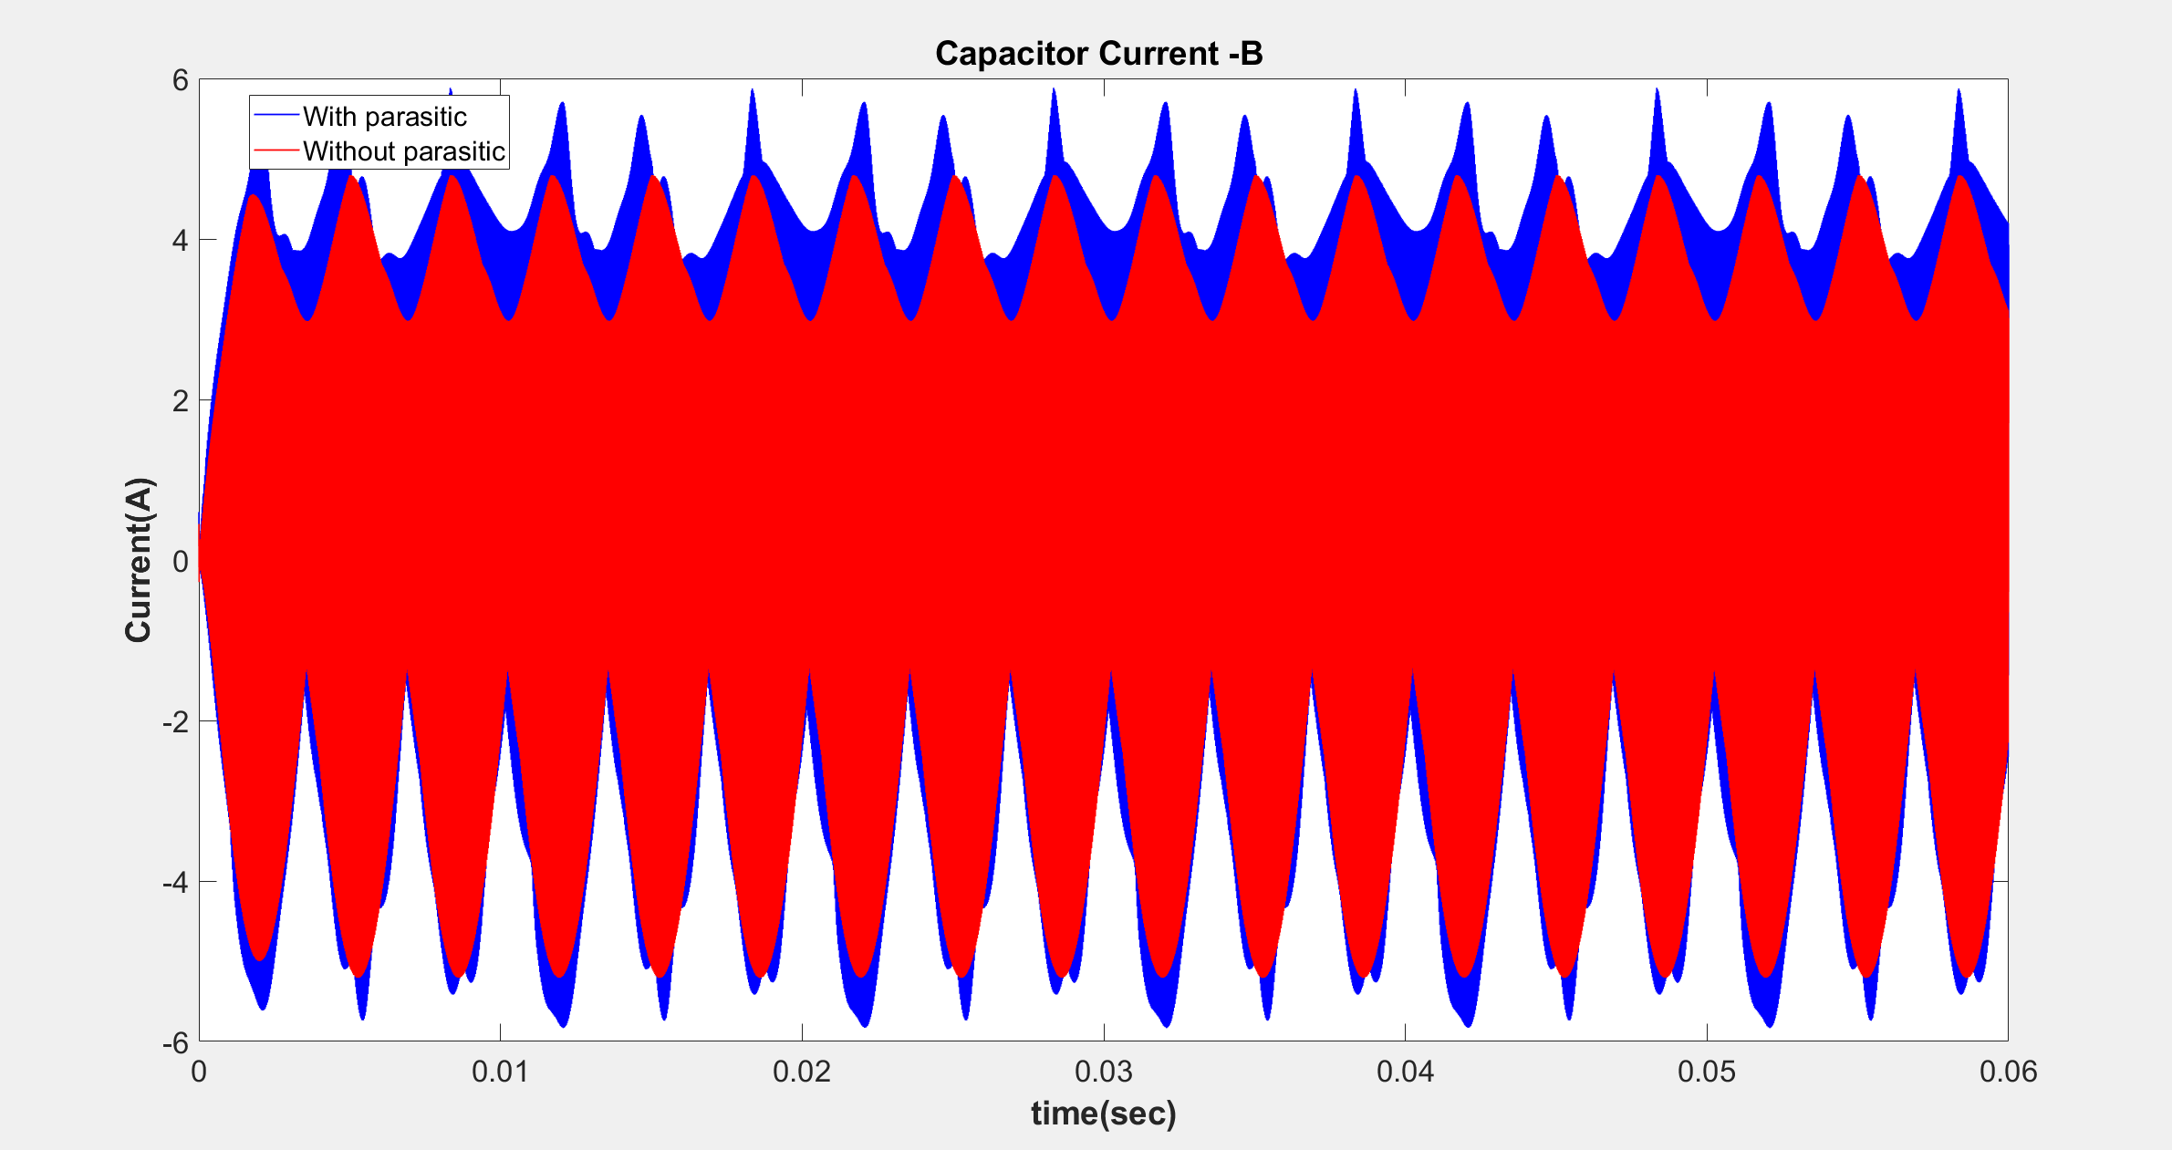

Slide 37
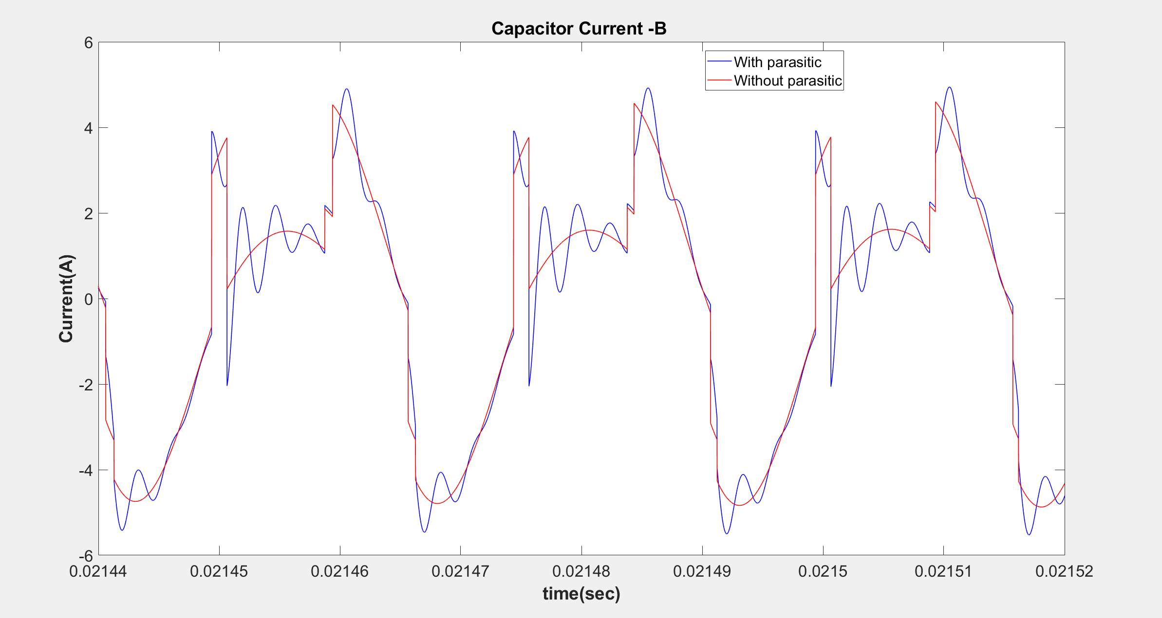

Slide 38
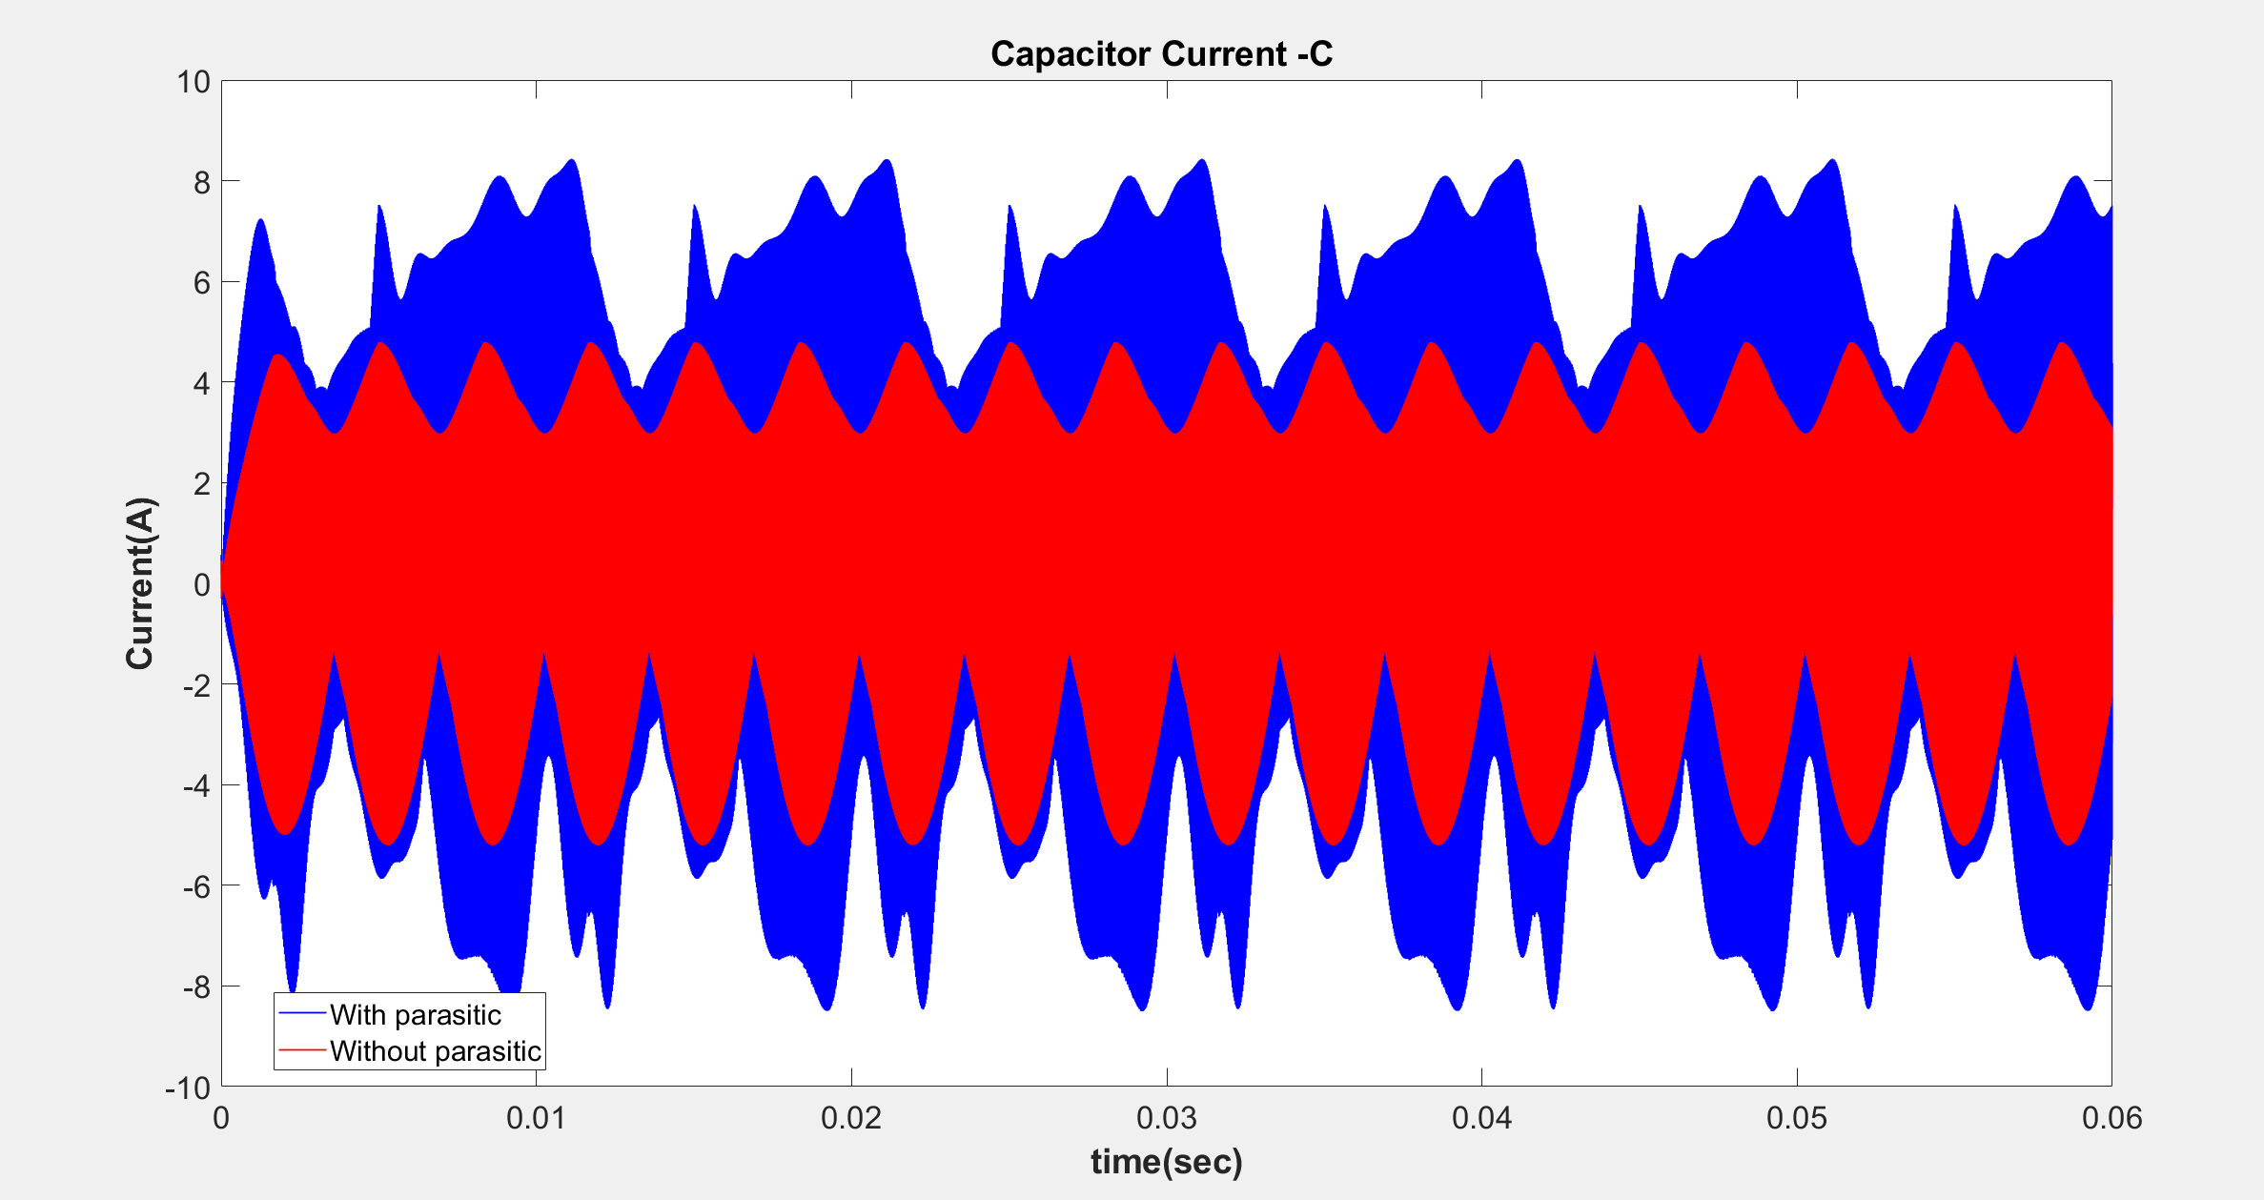

Slide 39
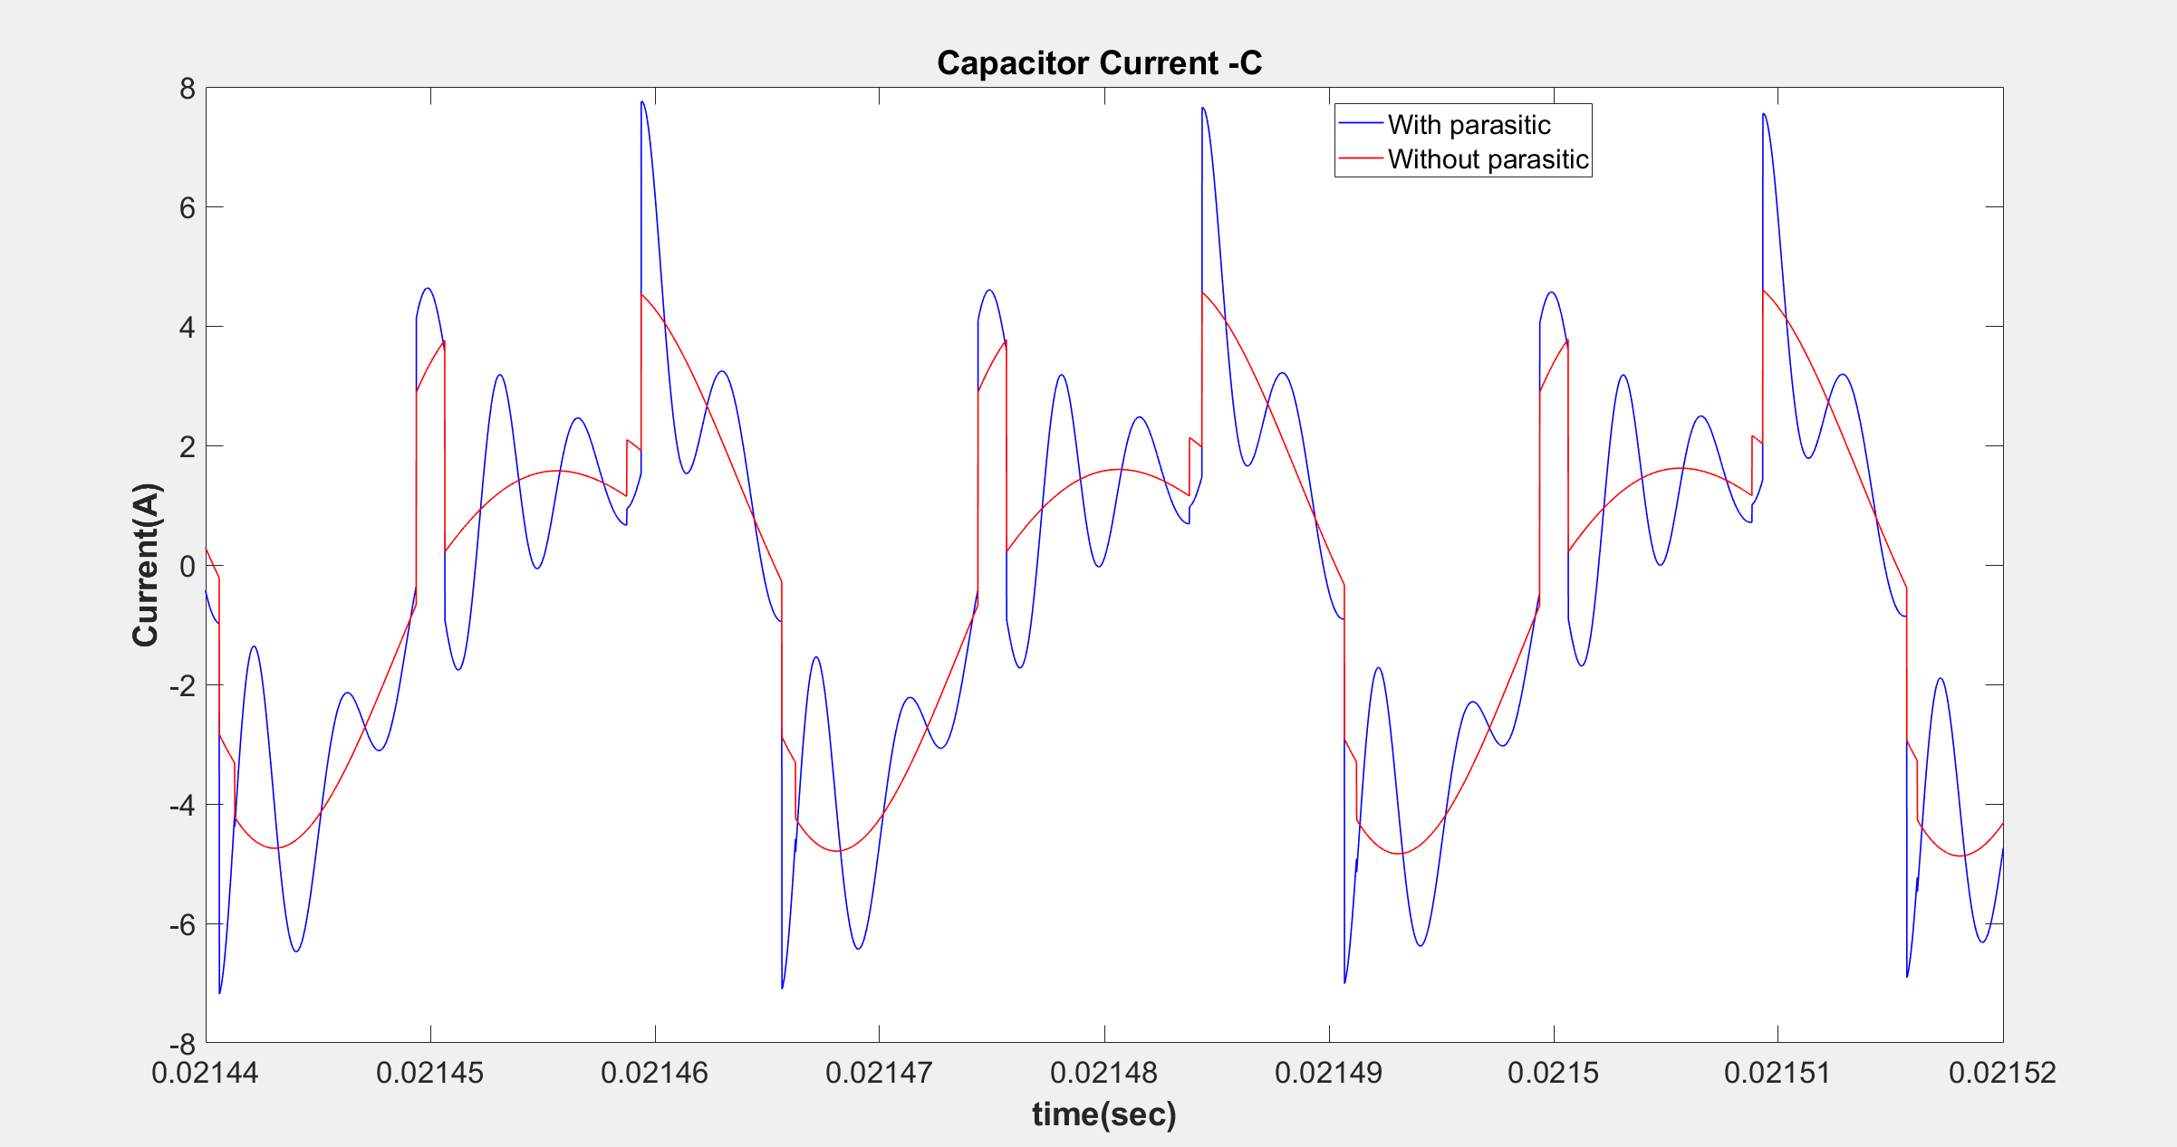

Slide 40
Frequency DOMAIN COMPARISONS
Comparison of input currents
Comparison of leg currents
Comparison of capacitor currents

Slide 41
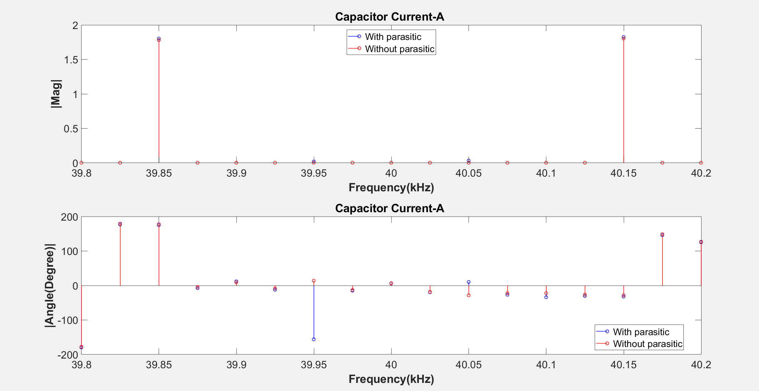

Slide 42
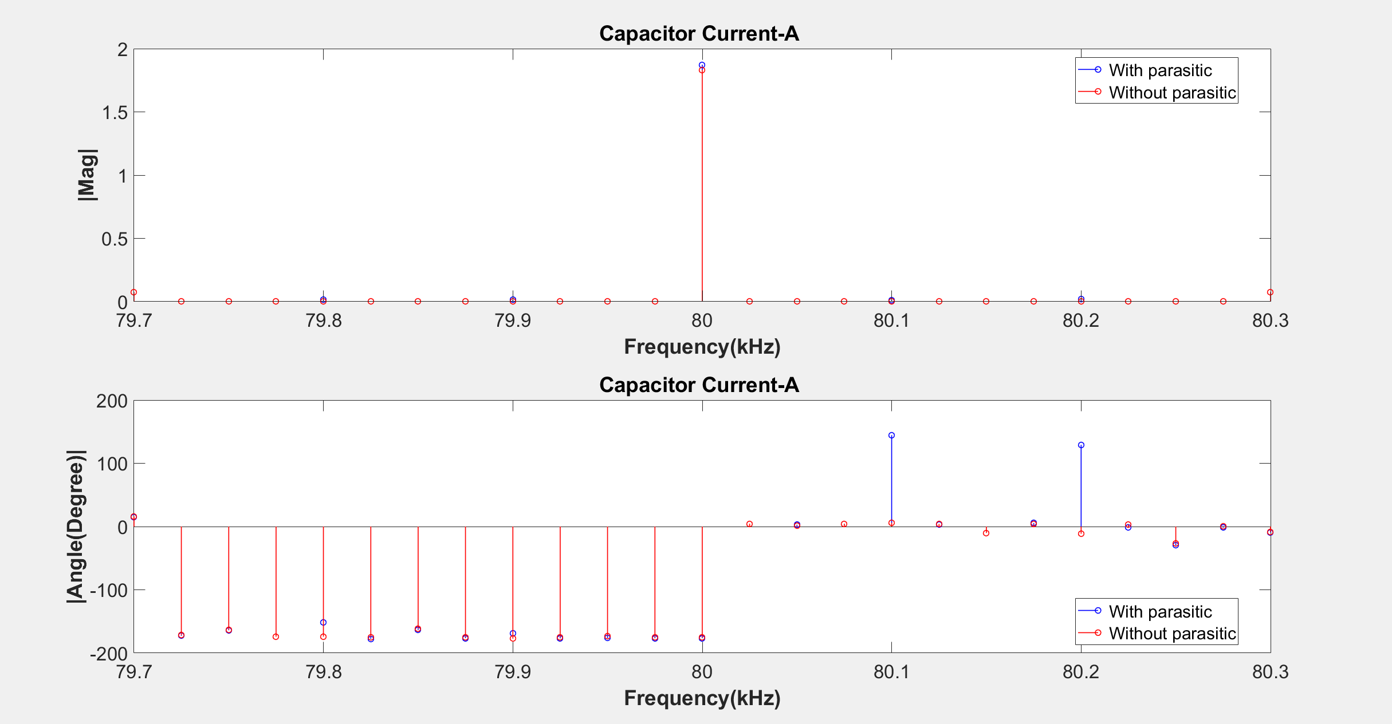

Slide 43
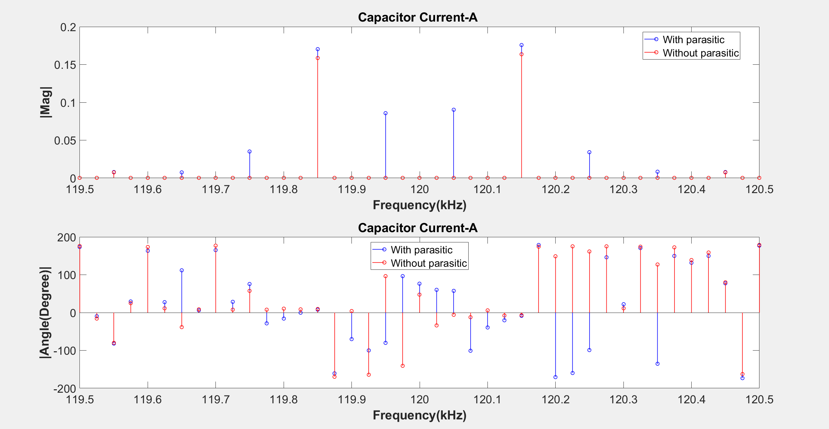

Slide 44
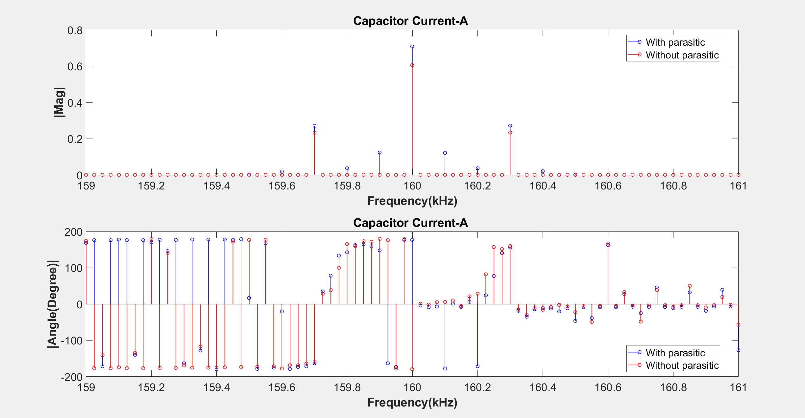

Slide 45
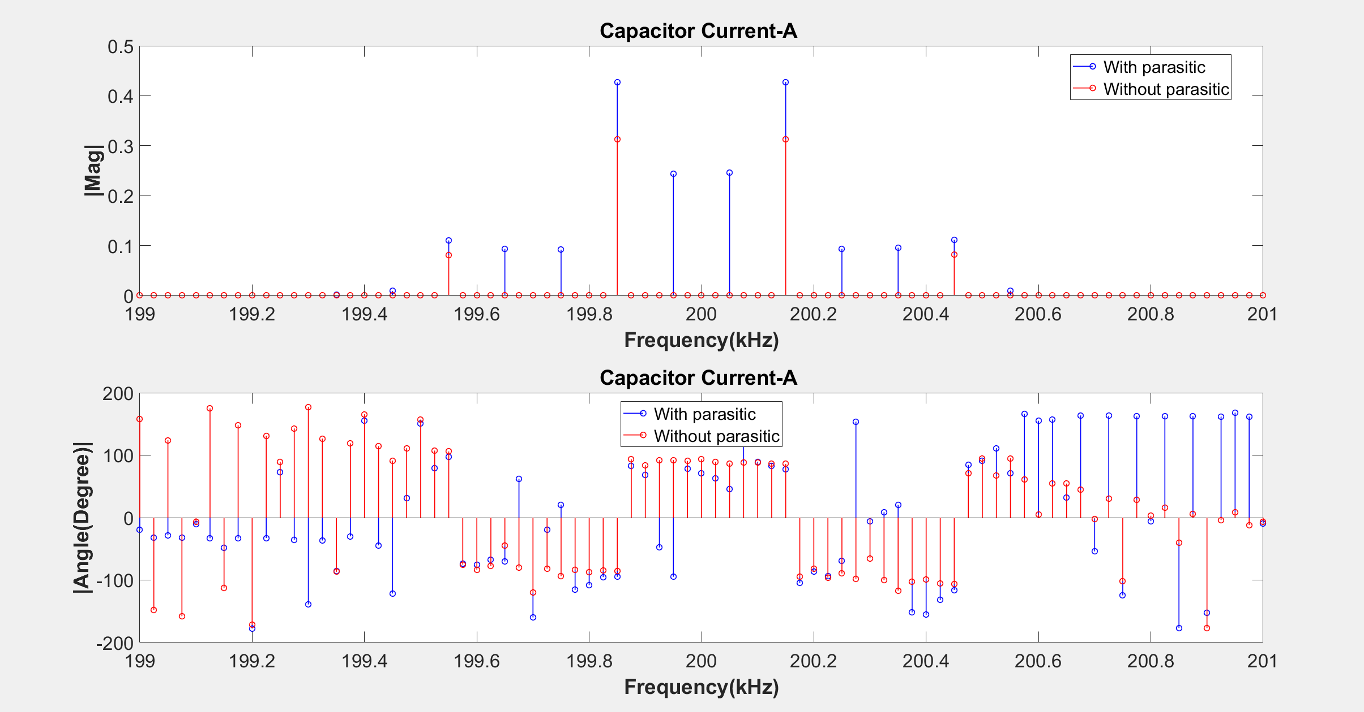

Slide 46
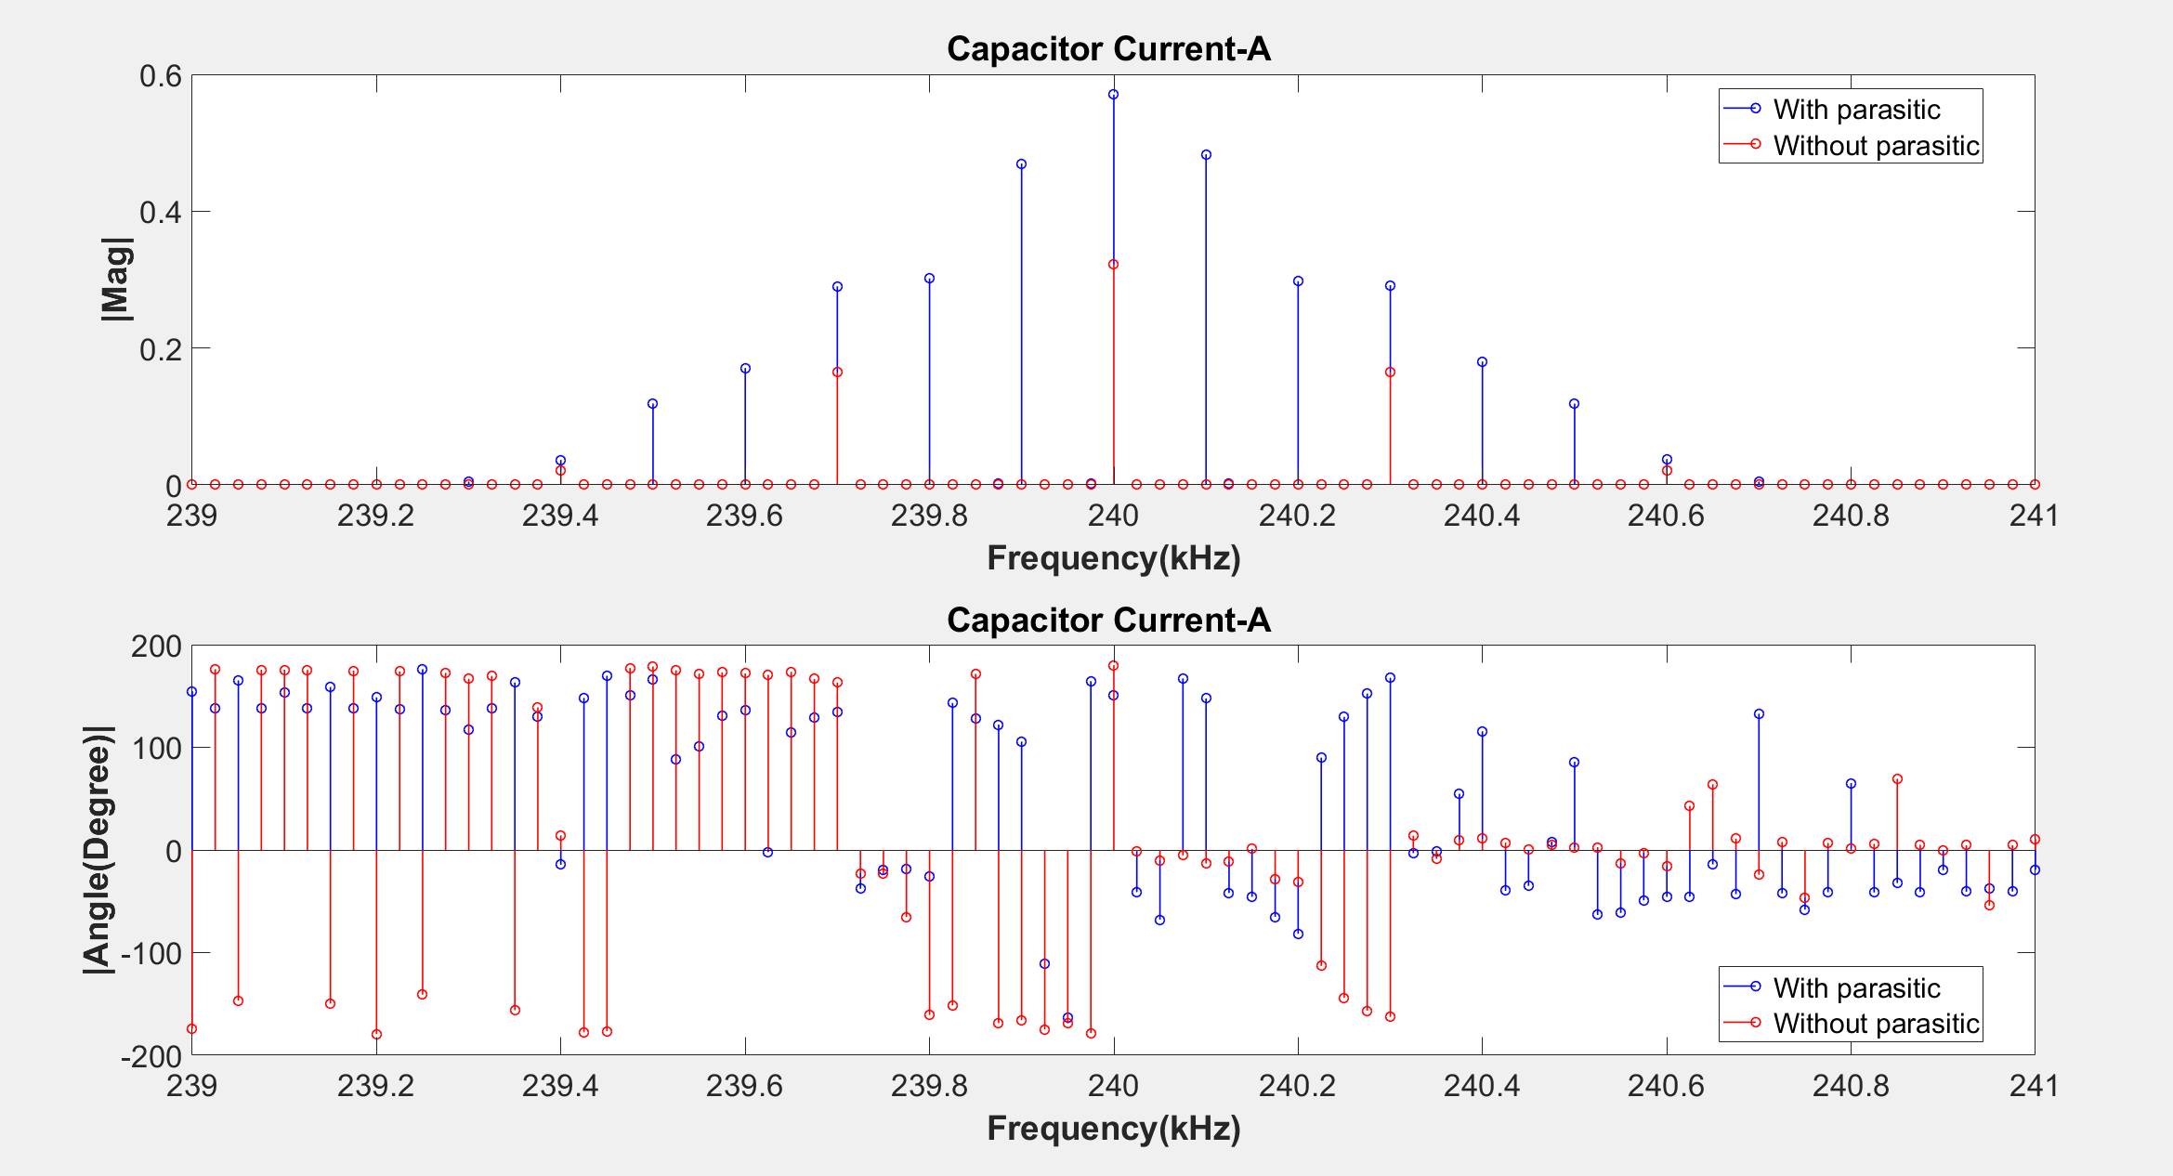

Slide 47
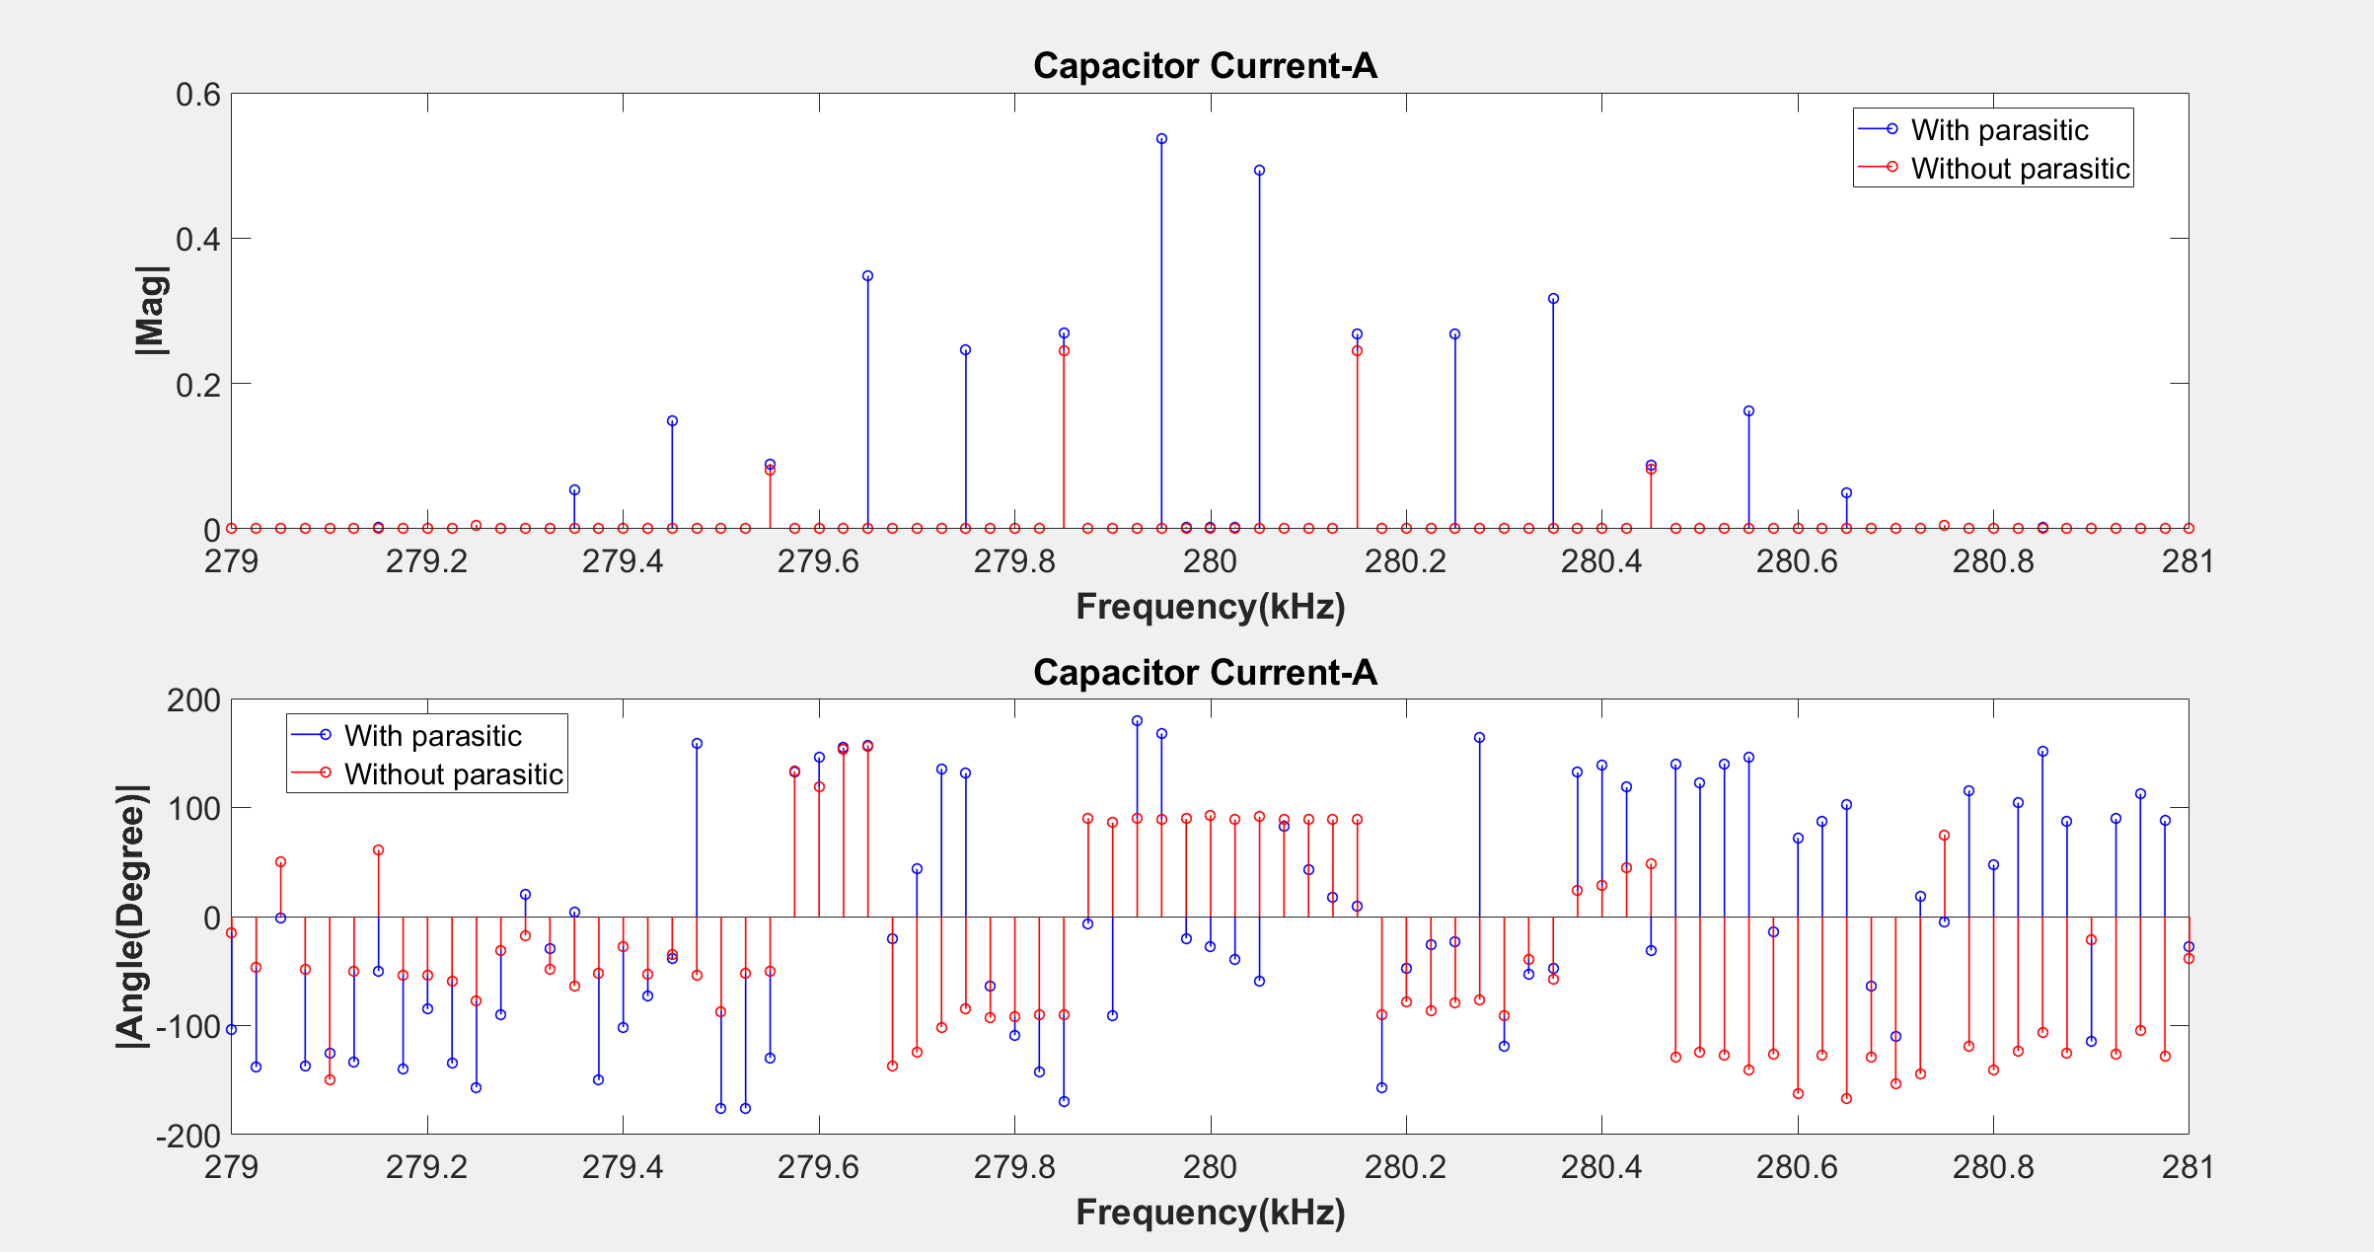

Slide 48
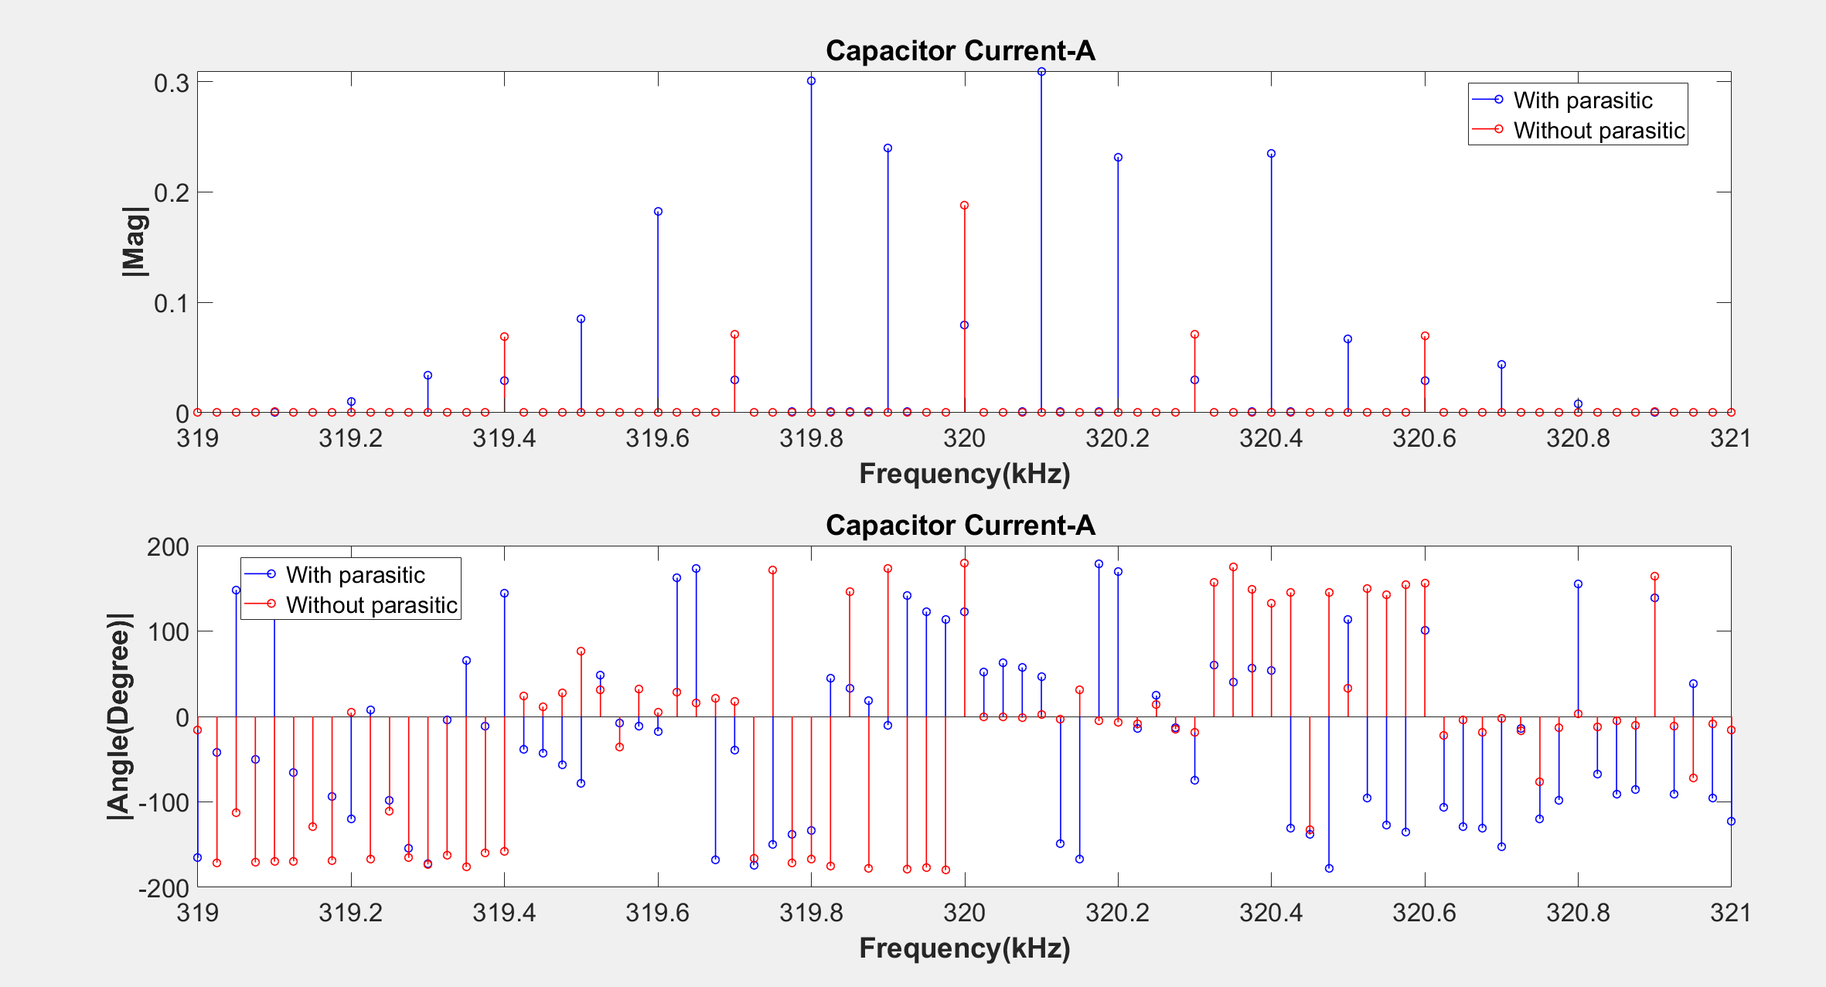

Slide 49
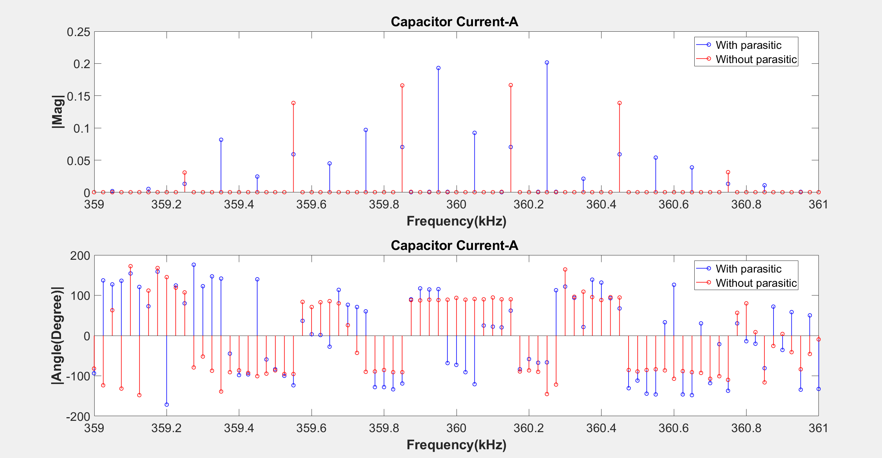

Slide 50
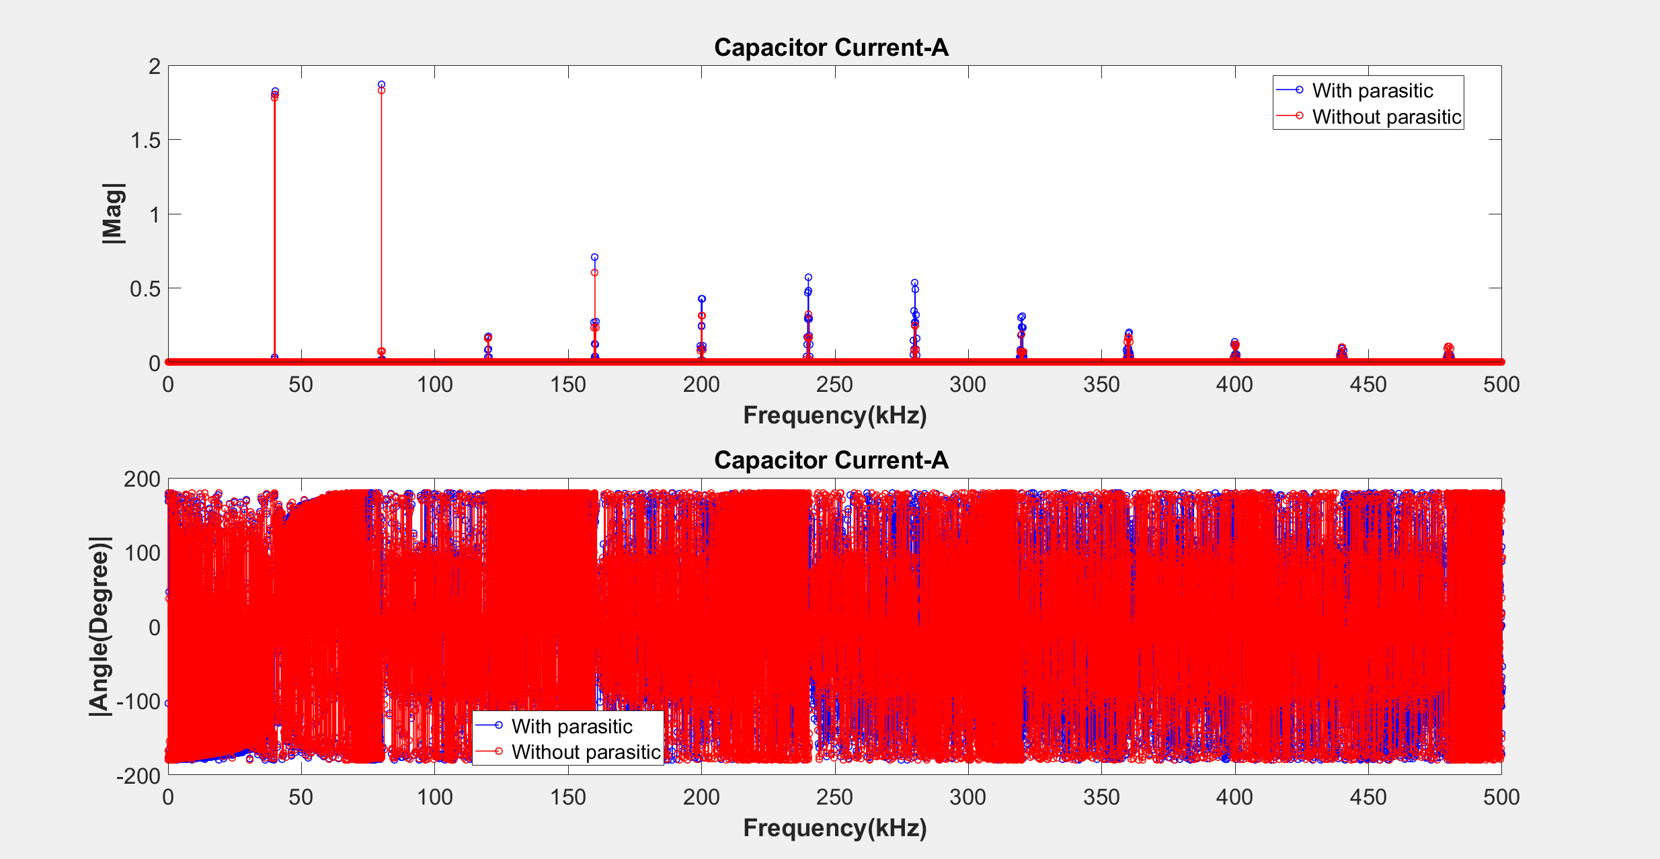

Slide 59
Impedance Model

Slide 60
Frequency (kHz) | phA |Mag| | phB |Mag| | phC |Mag| | phA |Angle| | phB |Angle| | phC |Angle|
39850 | 0.3289 | 0.3376 | 0.3411
40150 | 0.3289 | 0.3376 | 0.3412
80000 | 0.3142 | 0.3516 | 0.3672
119750 | 0.2839 | 0.3795 | 0.4211
119850 | 0.2838 | 0.3796 | 0.4212
119950 | 0.2837 | 0.3797 | 0.4214
120050 | 0.2836 | 0.3798 | 0.4216
120150 | 0.2835 | 0.3799 | 0.4218
120250 | 0.2834 | 0.3800 | 0.4220

Slide 61
Frequency (kHz) | phA |Mag| | phB |Mag| | phC |Mag| | phA |Angle| | phB |Angle| | phC |Angle|
159700 | 0.2219 | 0.4344 | 0.5321
159800 | 0.2216 | 0.4346 | 0.5325
159900 | 0.2214 | 0.4348 | 0.5329
160000 | 0.2212 | 0.4350 | 0.5333
160100 | 0.2210 | 0.4352 | 0.5337
160200 | 0.2207 | 0.4354 | 0.5341
160300 | 0.2205 | 0.4356 | 0.5345

Slide 62
Frequency (kHz) | phA |Mag| | phB |Mag| | phC |Mag| | phA |Angle| | phB |Angle| | phC |Angle|
199550 | 0.0702 | 0.5605 | 0.8062
199650 | 0.0696 | 0.5611 | 0.8074
199750 | 0.0689 | 0.5616 | 0.8086
199850 | 0.0683 | 0.5621 | 0.8097
199950 | 0.0677 | 0.5626 | 0.8109
200050 | 0.0670 | 0.5631 | 0.8121
200150 | 0.0664 | 0.5637 | 0.8132
200250 | 0.0657 | 0.5642 | 0.8144
200350 | 0.0651 | 0.5647 | 0.8156
200450 | 0.0644 | 0.5652 | 0.8168
200550 | 0.0638 | 0.5658 | 0.8180

Slide 63
Frequency (kHz) | phA |Mag| | phB |Mag| | phC |Mag| | phA |Angle| | phB |Angle| | phC |Angle|
239400 | -0.6369 | 1.1020 | 2.1002
239500 | -0.6418 | 1.1057 | 2.1092
239600 | -0.6467 | 1.1094 | 2.1182
239700 | -0.6517 | 1.1131 | 2.1274
239800
239900
240000
240100
240200
240300
240400
240500
240600

